Slide 1


Business Data Management
BY:
Data Gyan

Slide 2

PURPOSE
This project focuses on building a system to gather and organize data about potential customers. By cleaning and integrating this information into a well-structured database, the goal is to understand customer needs better. The system will then help create personalized marketing campaigns, ensuring that the organization can effectively reach and meet the evolving preferences of its customers.
The ultimate goal is to establish a dynamic and continuously updated database that empowers personalized marketing strategies, ensuring that the organization can adapt and meet the evolving needs of its customer base.

Slide 3
The process involved in Data analysis
Stage 1: Data Collection & Cleansing
Stage 2: Data Transformation
Stage 3: Data Loading
Stage 4: Query-based Data Export
Stage 5: Data Visualization

Slide 4
Data Source
Sales Database
Internal Data base
Customer Database
Product Database

Slide 5
Aim of the Project: Unifying Data for Targeted Marketing Insights
The project's core objective is to systematically gather data from diverse sources, including customer data, sales records, internal databases, and protected datasets. The intent is to consolidate this information into a single, comprehensive database.
This unified repository aims to unlock valuable insights, specifically identifying potential customers for the company's future business and marketing endeavors. By employing this consolidated data, marketing companies can strategically direct their efforts and tailor advertisement strategies, enhancing the precision and effectiveness of customer targeting for sustained business growth.

Slide 6
Scope: Enhancing Sales Analysis for Sustainable Growth
The project's focus lies in analyzing historical data related to sales operations, sales states, and licensing. By leveraging advanced visualization techniques, the aim is to gain comprehensive insights into past sales performance.
The scope extends to ensuring optimal sales volume, fostering the growth of the organization, and strategically maximizing the current profits attained by the company. Through a thorough examination of these key aspects, the project seeks to provide actionable intelligence that will contribute to the sustained expansion and prosperity of the organization.

Slide 7
Data Collection
Structured Excel Template:
Created a user-friendly MS Excel template featuring key attributes like city, state, product name, category, sales, price, and email ID. This template served as a straightforward tool for gathering data from various sources.
Systematic Information Gathering:
Collected relevant data from internal and external sources, systematically filling in the designated Excel attributes. This organized approach ensured consistency and clarity in capturing essential information for analysis.
Integration into Master Database:
Integrated the collected data into a master database, mapping each attribute to its corresponding field. This collaborative effort established a centralized repository, laying the groundwork for in-depth analysis of sales operations, product performance, and customer behavior.

Slide 8
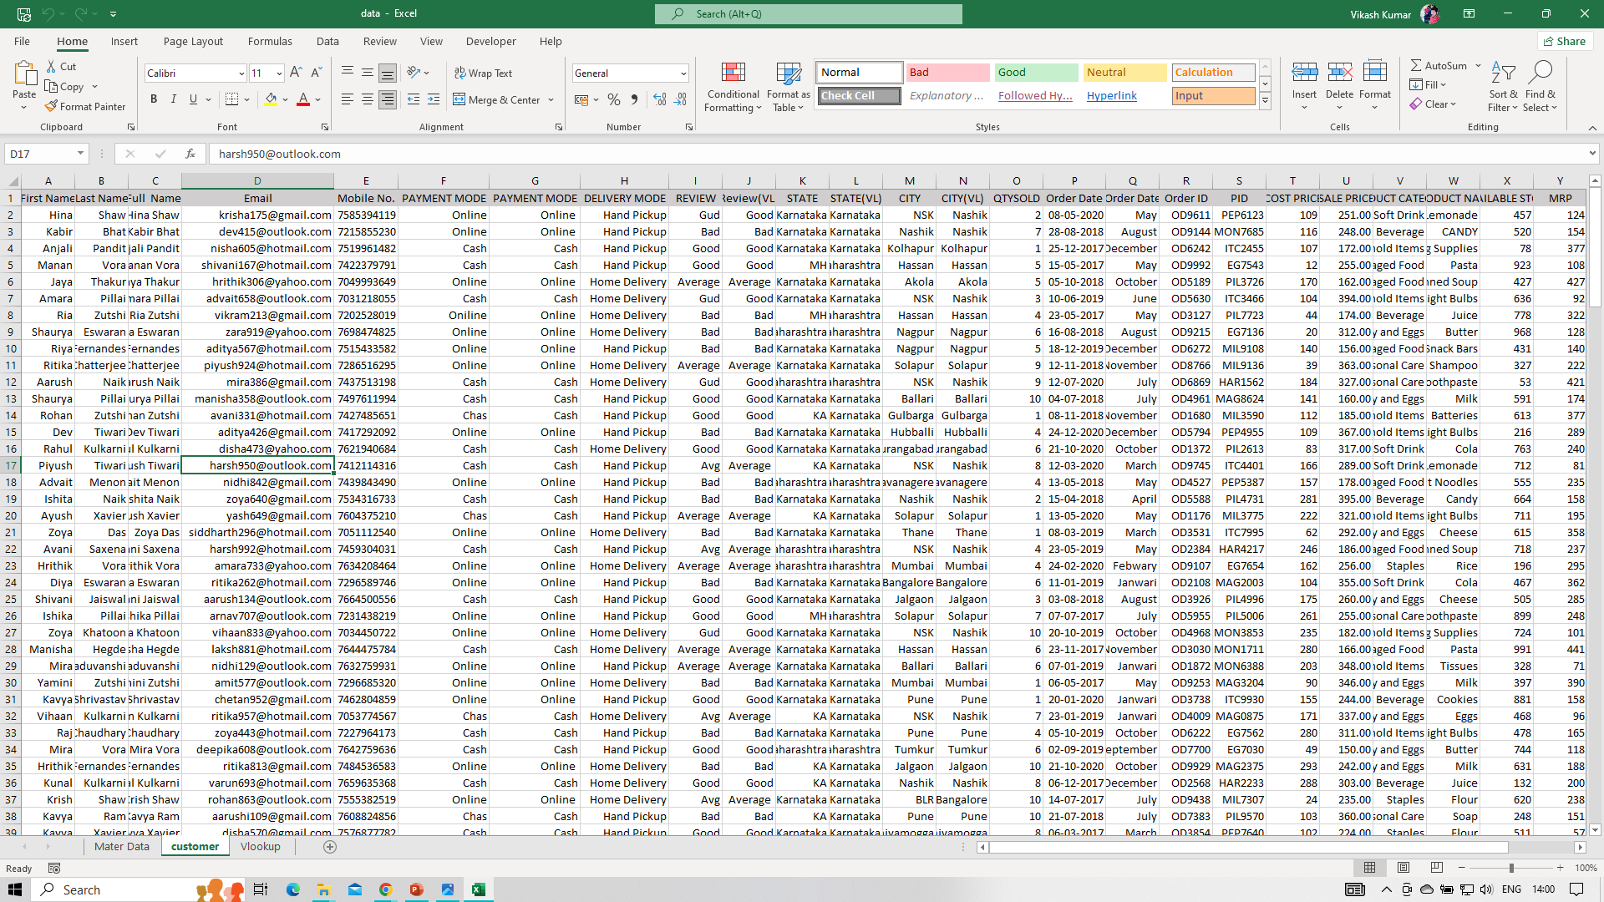
Data Collection Snapshot from Mart Customers
Attribute Inclusion:
Included crucial details like customer ID, first name, full name, email ID, mobile, payment, delivery, and reviews in the Excel sheet.
Direct Input from 200 Customers:
Personally gathered data from 200 Mart customers, ensuring direct and accurate information input.
Data Scrutiny for Integrity:
Conducted thorough scrutiny to guarantee data completeness and accuracy, addressing any discrepancies in attributes like state and city.

Slide 9
Data Cleaning for Master Data Compilation:
Standardizing Attributes:
Ensure uniformity in attributes like payment mode, delivery mode, review state, and city for consistent analysis.
Cleansing Customer Information:
Modify and clean customer details, including first name, last name, full name, email, and mobile number, for uniform presentation in the Master Data set.
Addressing Date Discrepancies:
Adjust date formats in attributes like order date, entry date, and exit date to create a standardized timeline for analysis.
Ensuring Data Integrity:
Scrutinize sales data, product categories, and internal data entries to identify and rectify any anomalies, ensuring the integrity of the Master Data compilation.

Slide 10
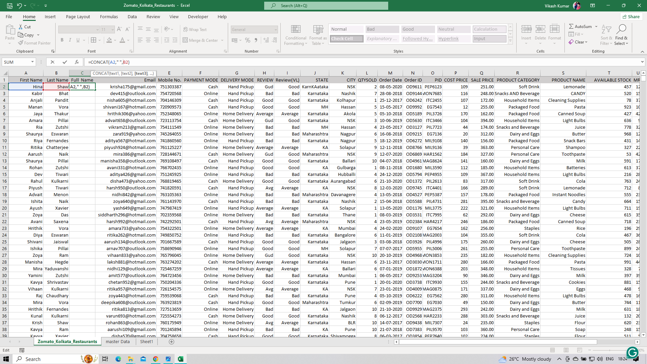
Creating Full Names from First and Last Names:
Concatenating first names and last names to generate full names, addressing missing data, and ensuring uniformity for a standardized dataset and enhanced data integrity.

Slide 11
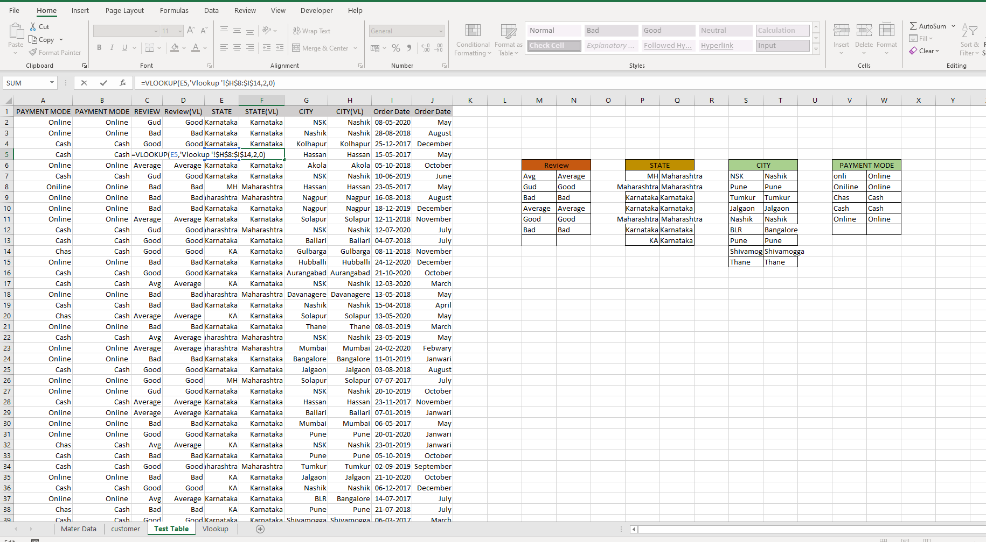
Creating Lookup Table for Data Standardization:
To standardize diverse data entries, a Lookup Table has been devised, as seen in the attached screenshot.
Employing Excel's VLOOKUP function, this table enables the conversion of abbreviated
city or state names, numeric representations of months in sales data, and entry/exit months
in internal data into standardized names (e.g., May, January).
This lookup mechanism ensures consistency and clarity in the dataset,
enhancing the overall quality of the data for analysis.

Slide 12
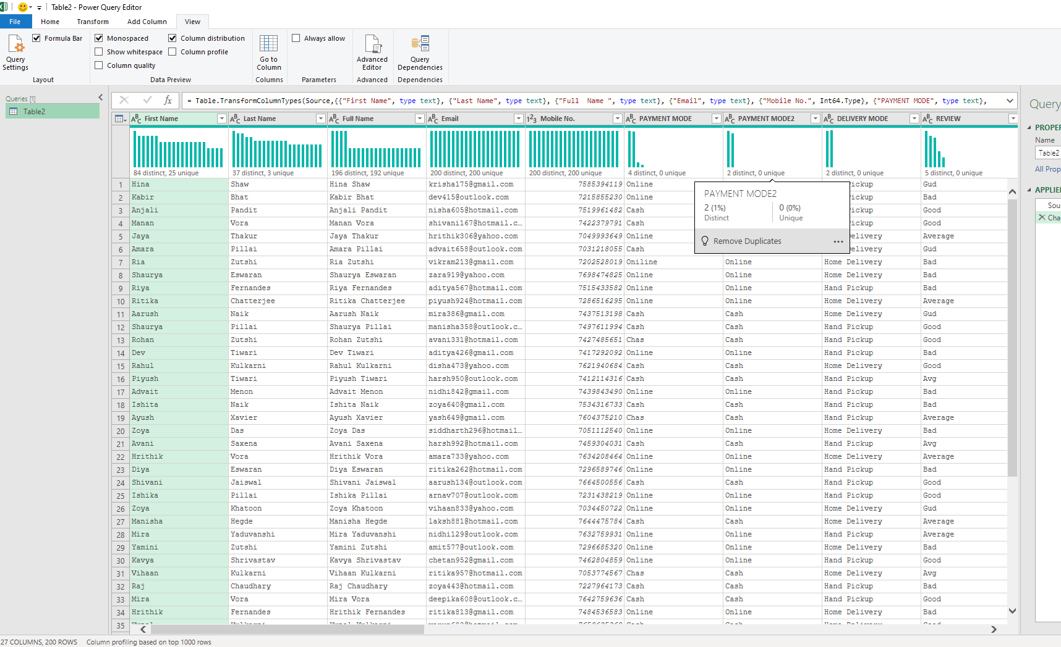
Data Profiling
Data profiling involves scrutinizing the available information in files or databases to extract valuable insights into data quality. For instance, in our customer data, the City column underwent profiling using Power Query. This revealed discrepancies such as misspelled city names and incorrect entries. By utilizing queries within Power Query, we aimed to assess the accuracy of the City column, ensuring data integrity and identifying areas for improvement in the dataset.

Slide 13
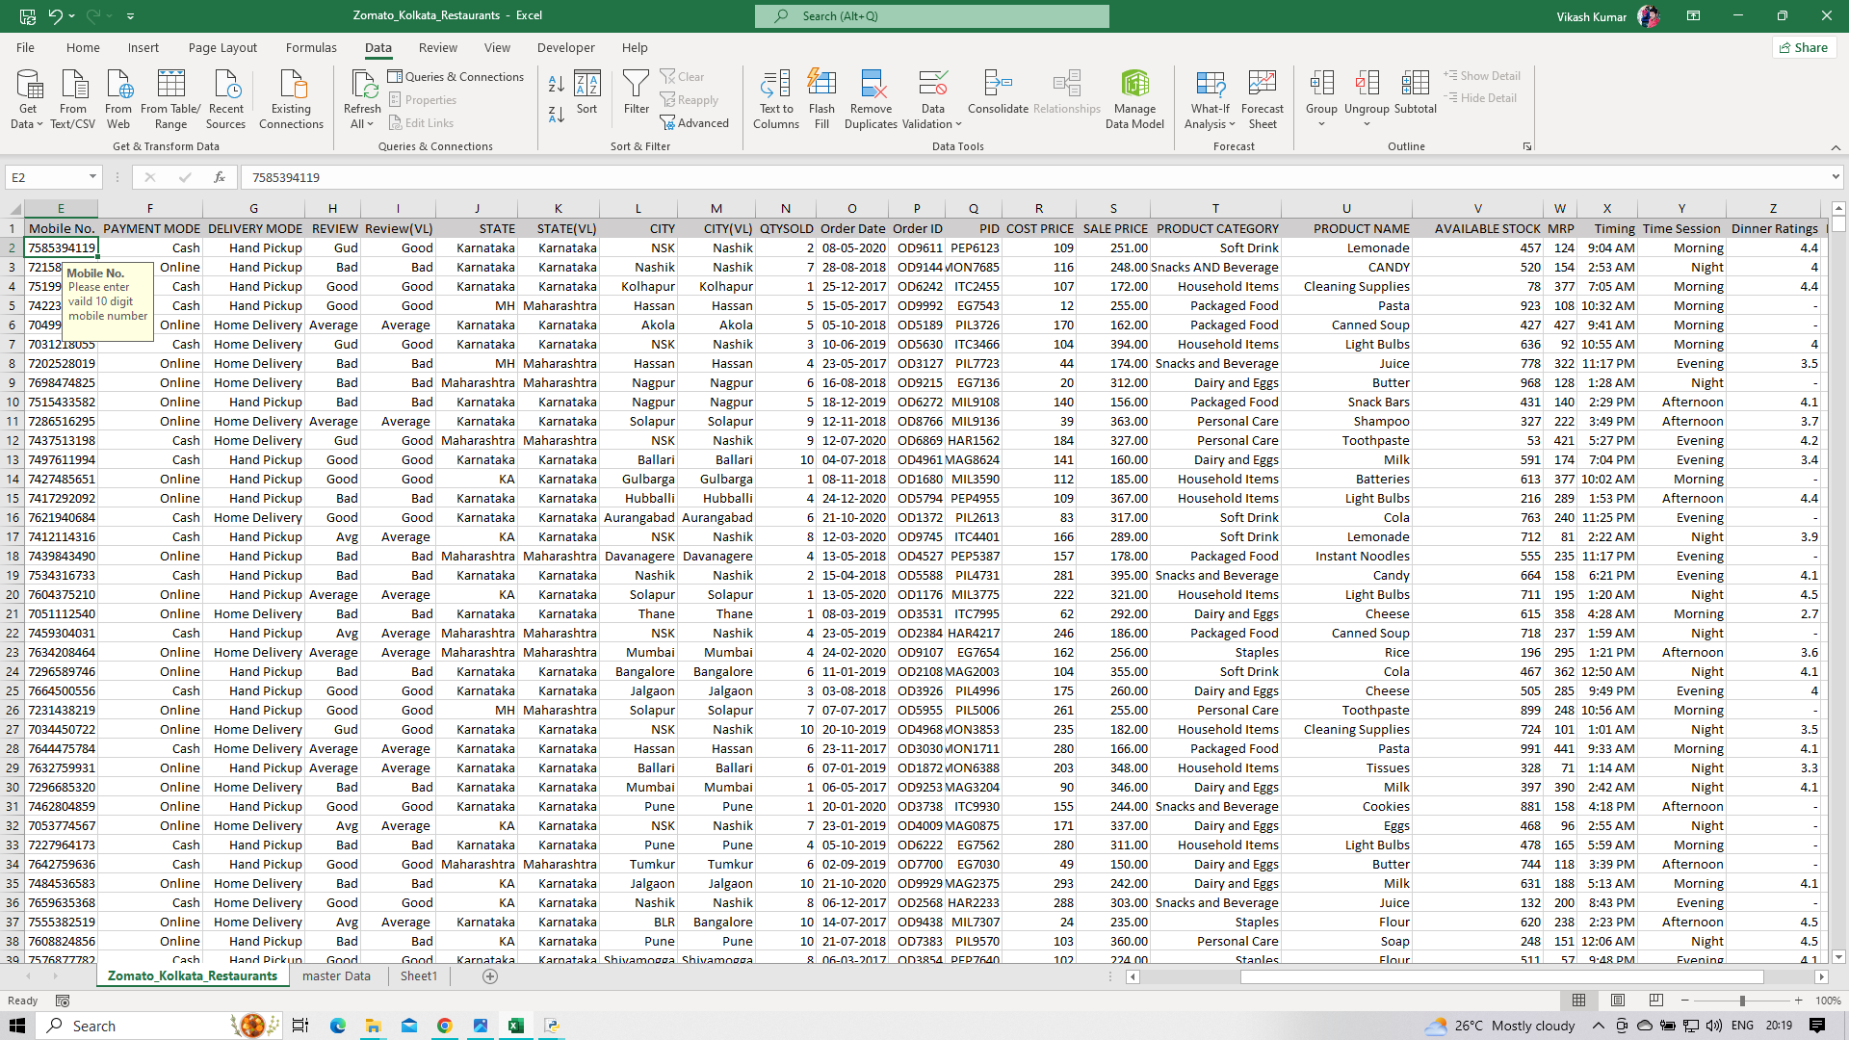
Data Validation
In ensuring data integrity, data validation is employed for fields like mobile numbers in customer databases. An example is restricting mobile numbers to 10 digits. This validation process safeguards against errors and ensures that only accurate and properly formatted data is accepted, maintaining the quality and consistency of the dataset

Slide 14
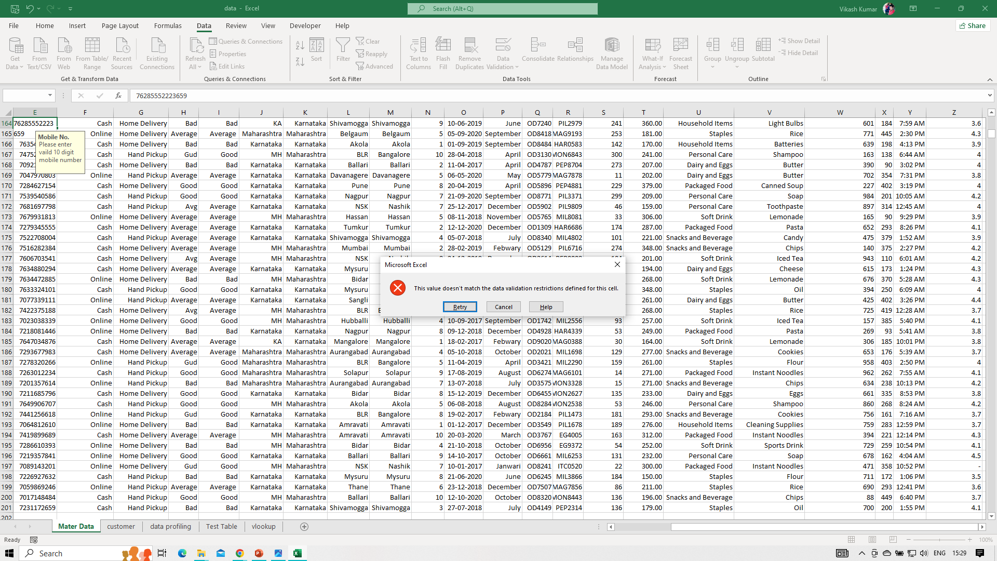
Handling Validation Errors:
When data fails validation, it triggers validation errors, preventing the input of incorrect or modified data. Refer to the attached screenshot for an illustration of the validation error message. This proactive measure ensures the integrity and accuracy of the dataset by restricting the entry of data that does not adhere to specified validation criteria.

Slide 15
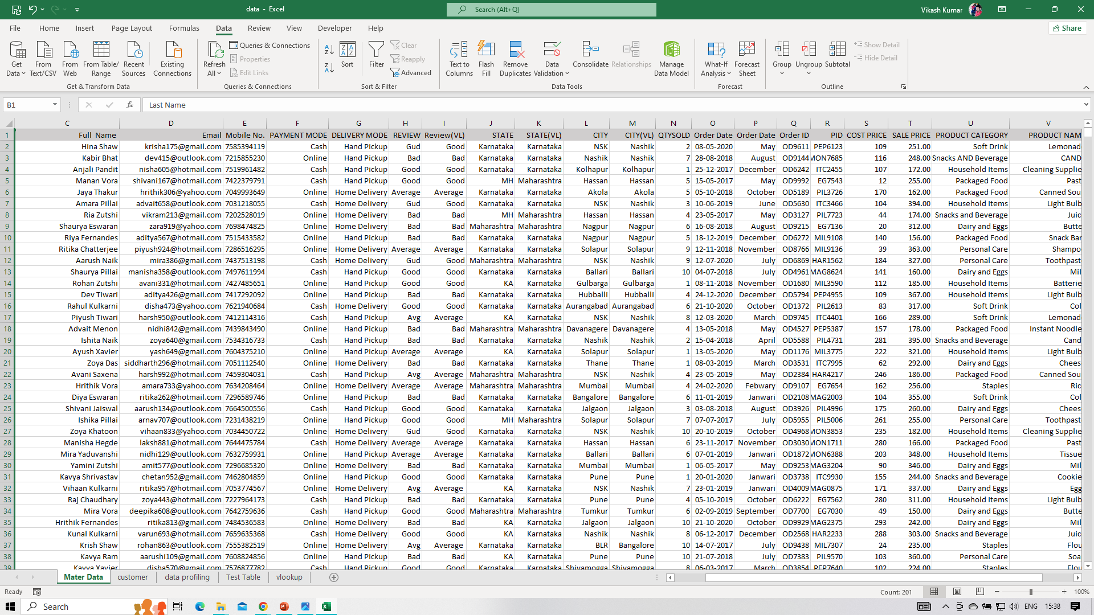
Master Data Snapshot:
After the completion of the data cleaning process, the Master Data takes on a refined and structured appearance. The dataset now exhibits uniformity, accuracy, and adherence to standardized formats, ensuring its readiness for analysis and utilization in various business operations.

Slide 16
Loading Data into SQL Server:
SQL Server is a relational database management system developed by Microsoft, designed to efficiently store and manage large volumes of data.
In contrast to the limited capacity of MS Excel, SQL Server provides a scalable solution for handling extensive datasets, making it particularly advantageous in organizations with a multitude of Master Data files.
Its ability to handle significant data volumes and facilitate tailored data extraction based on specific requirements makes SQL Server a valuable tool for robust and streamlined data management in scenarios where Excel's capacity may be limiting.

Slide 17
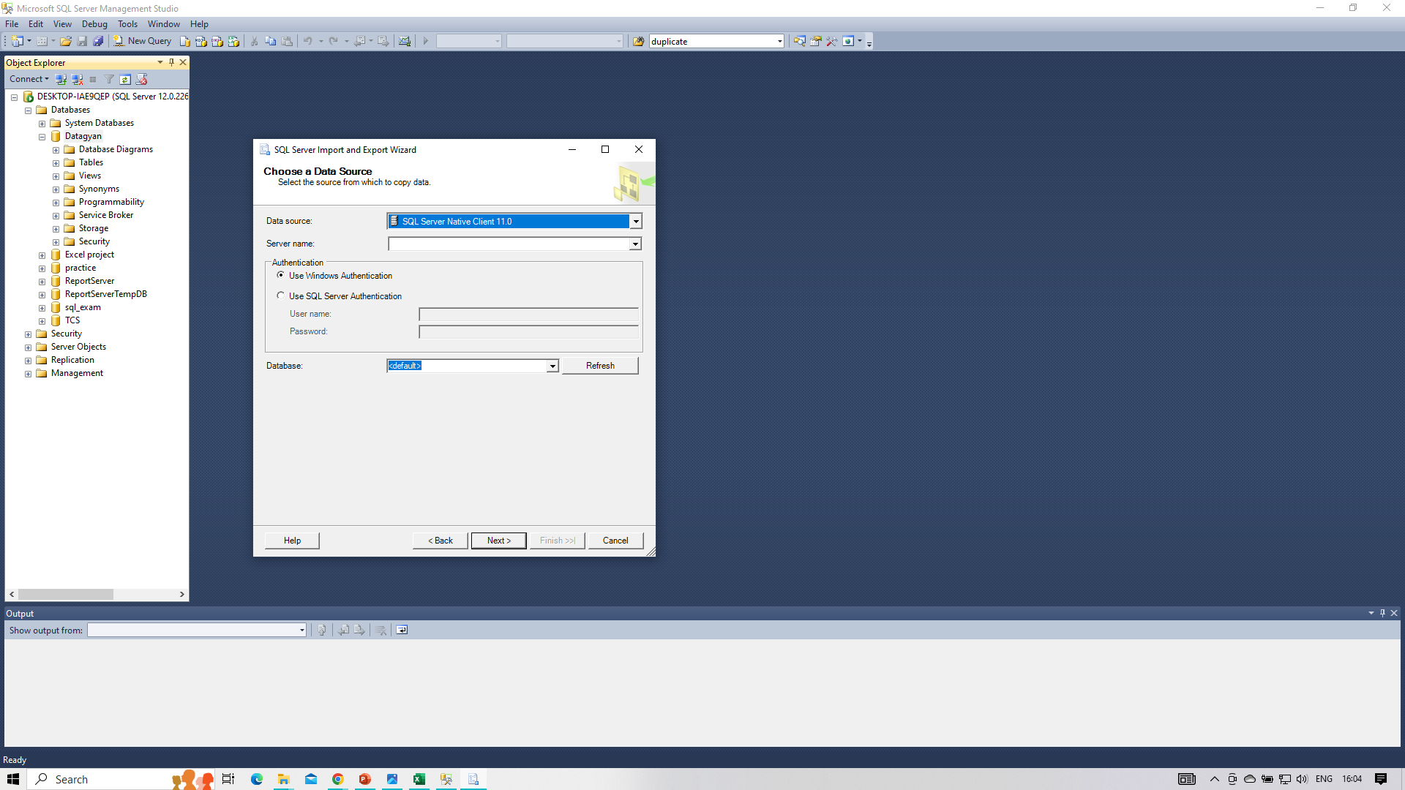
Selecting SQL Server Native Client 11.0 as the Destination:
Choosing the SQL Server Native Client 11.0 as the destination serves as an optimal choice for storing files into a SQL Server database.

Slide 18
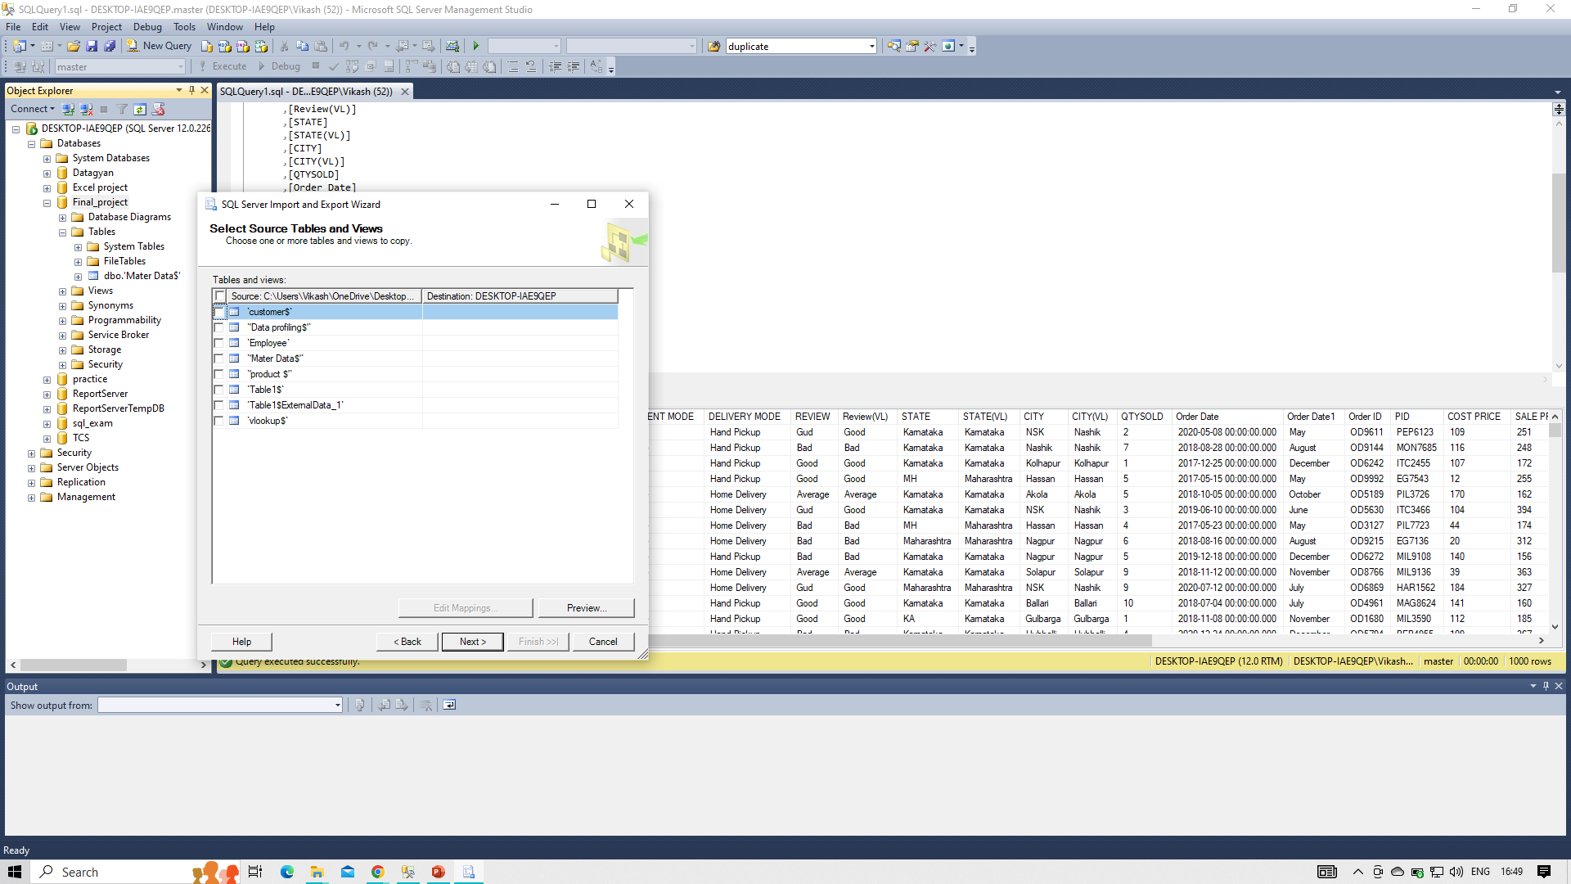
Selecting Seats and Modifying Destination:
Choose specific data fields (seats) from the source file for import, ensuring relevance. Modify the destination settings, specifying SQL Server Native Client 11.0, and configure precise mappings for an accurate and streamlined data transfer.

Slide 19
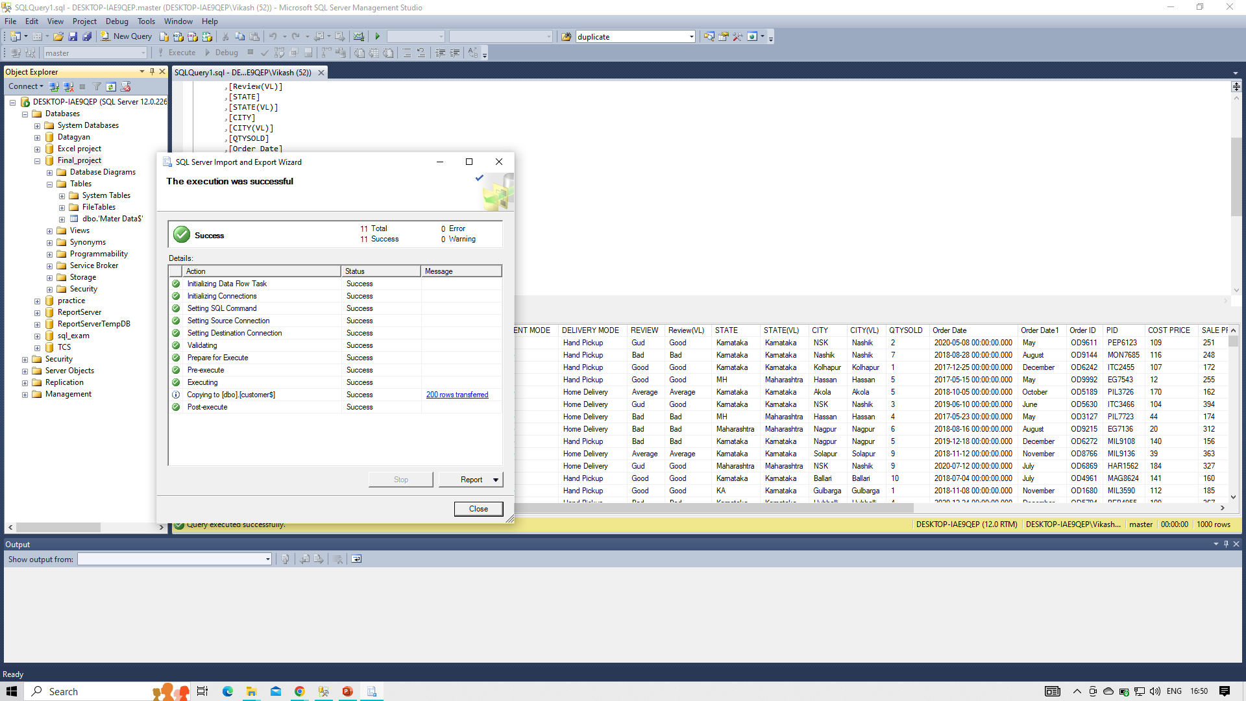
SQL Server Table Display:
After successfully loading seats from Excel into the dedicated database, the SQL Server table will display the imported data. Refer to the attached screenshot for a visual representation of how the data appears in the SQL Server table, providing a clear view of the organized and structured dataset within the database.

Slide 20
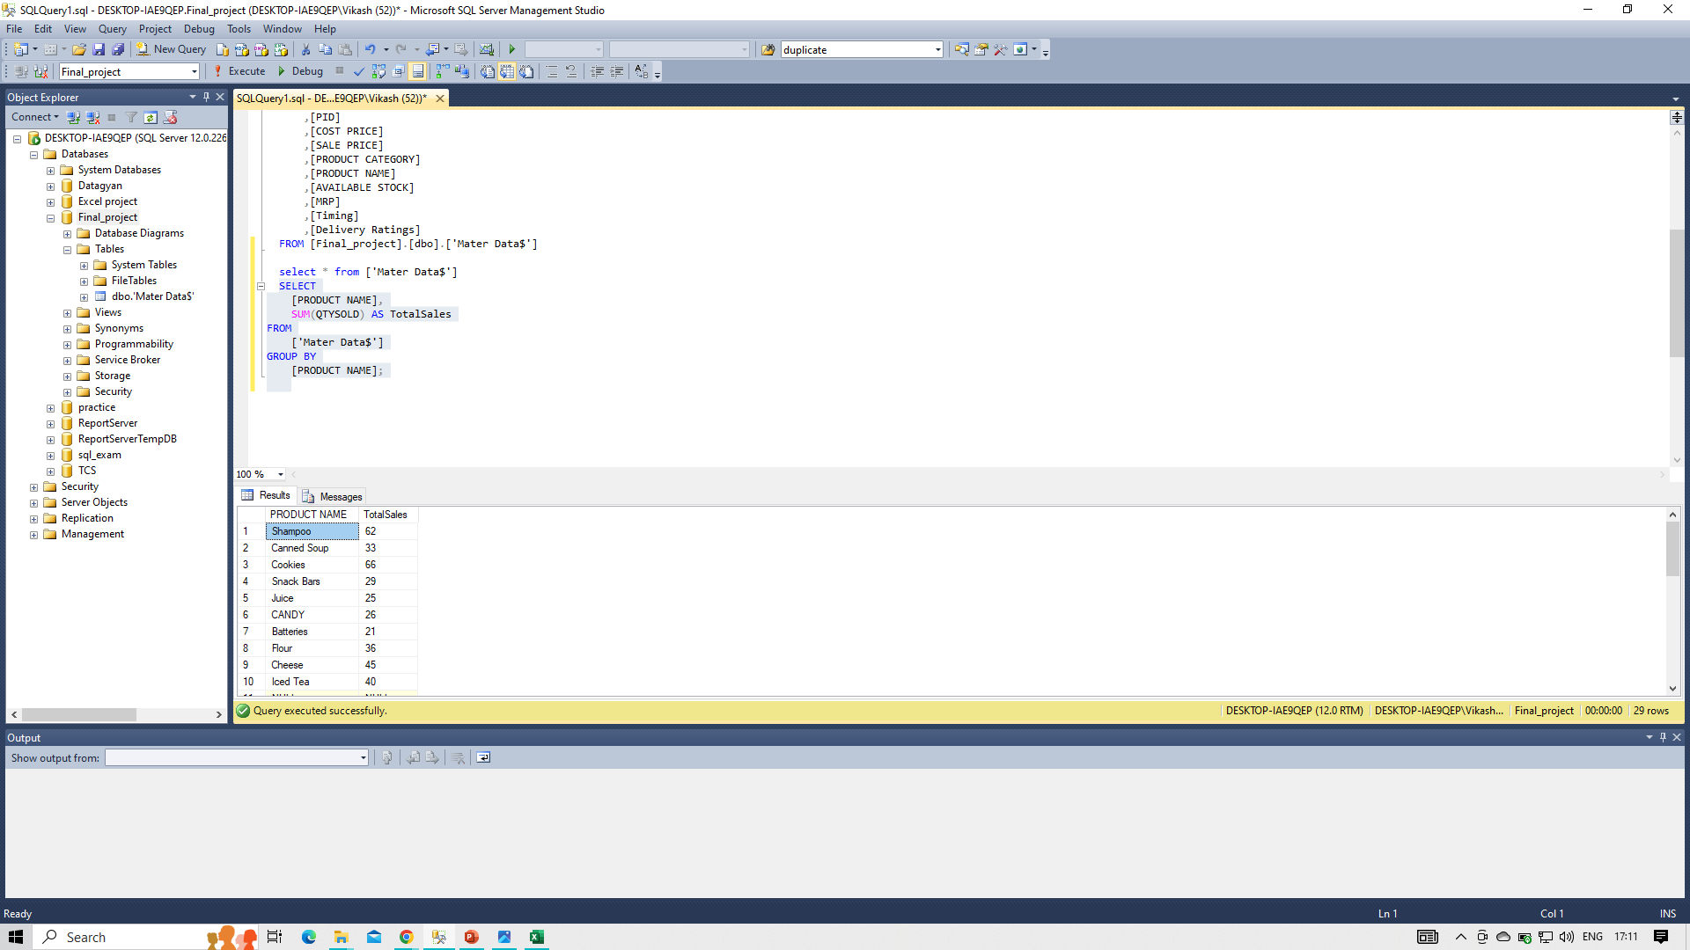
Data Querying for Specific Insights
For Example:
"Analyzing Sales Data: Total Sales Product-wise"

Slide 21
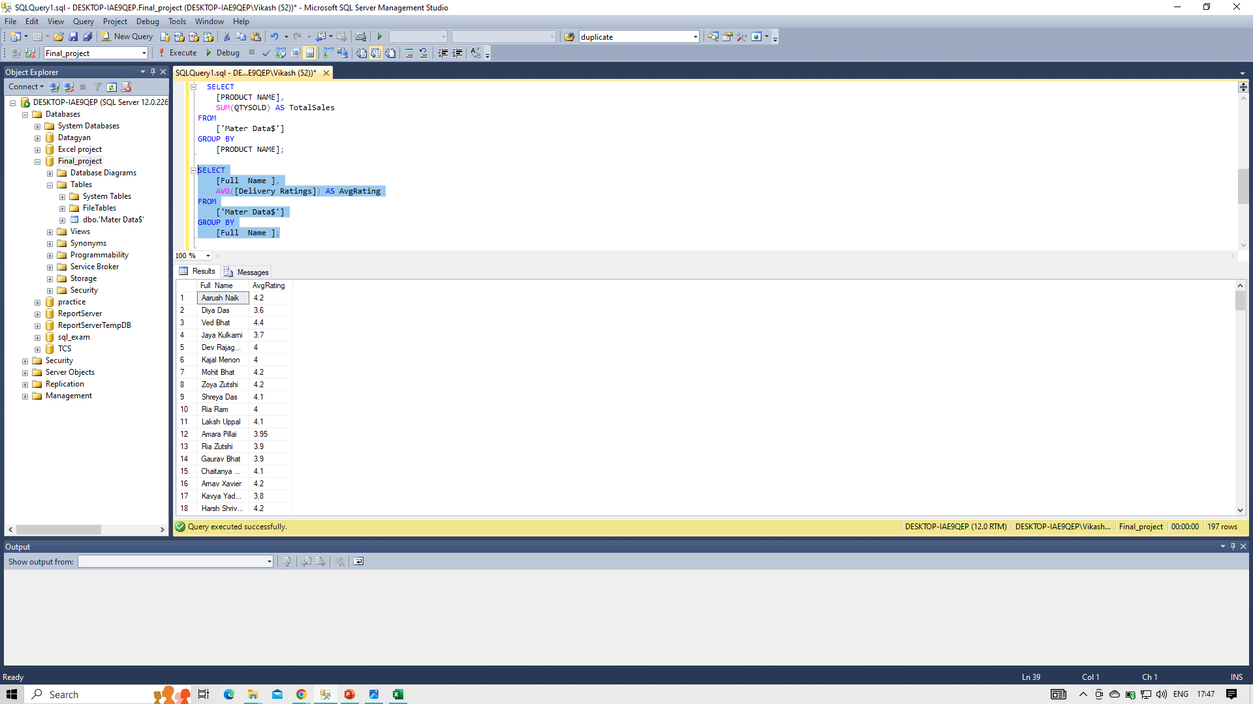
Customer Reviews Analysis:

Slide 22
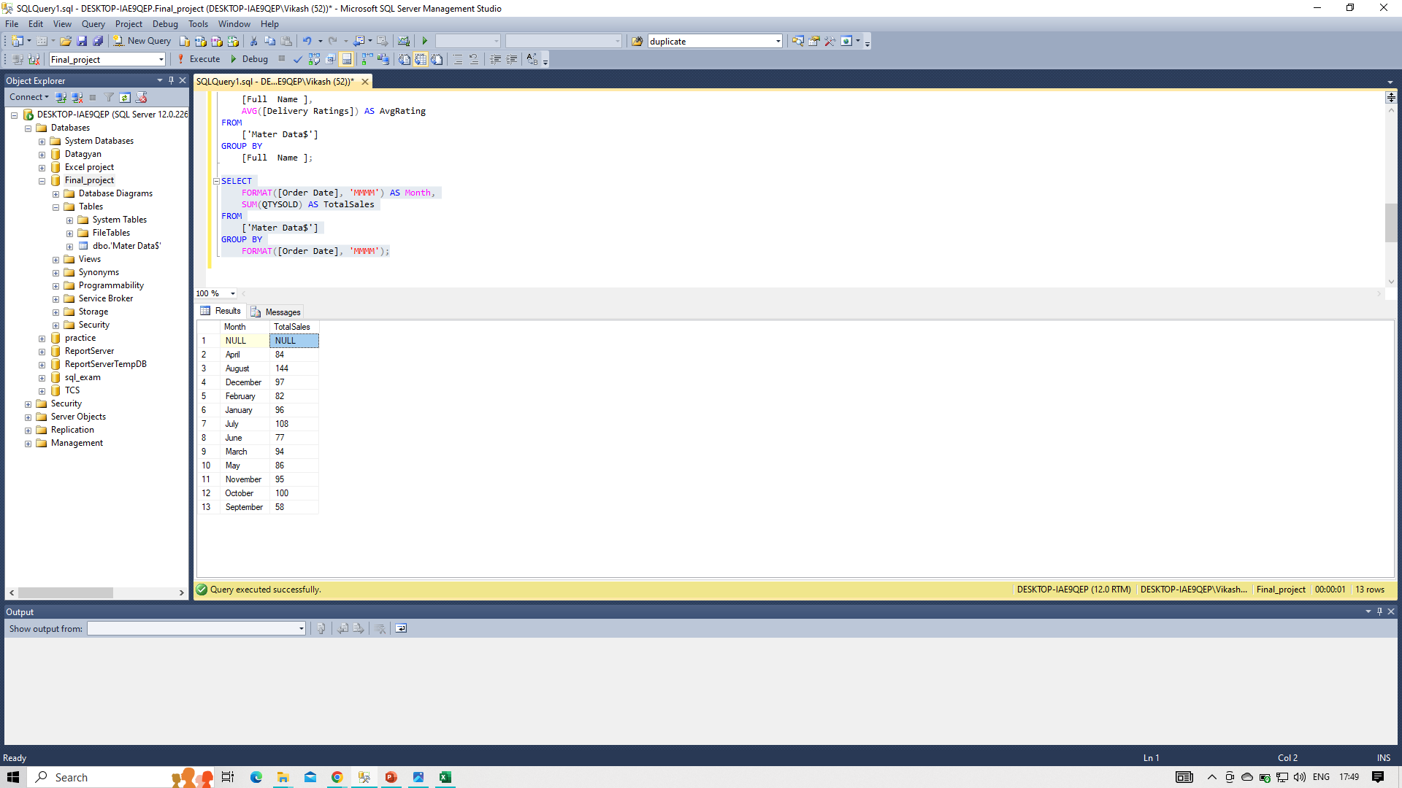
Monthly Sales Overview:

Slide 23
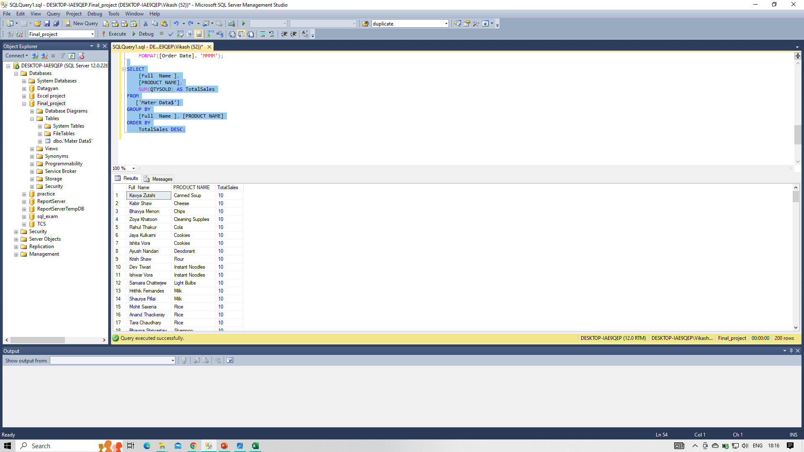
"Advanced Data Analytics for Comprehensive Insights"
Top Performers Analysis:
Identify top-performing individuals and products based on total sales.

Slide 24
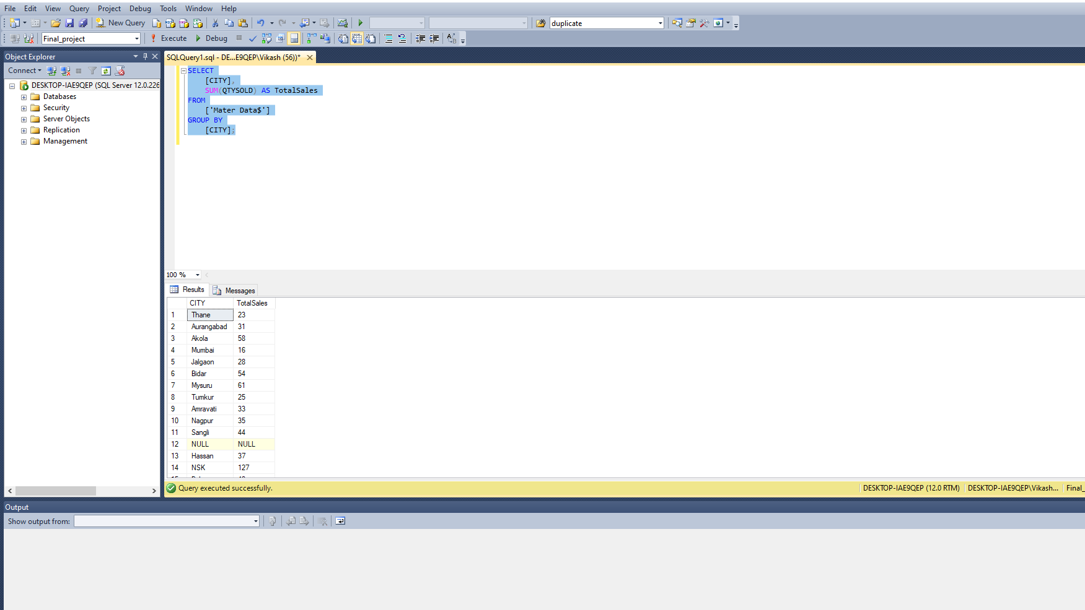
Geographical Sales Breakdown:
Gain insights into sales distribution across different cities.

Slide 25
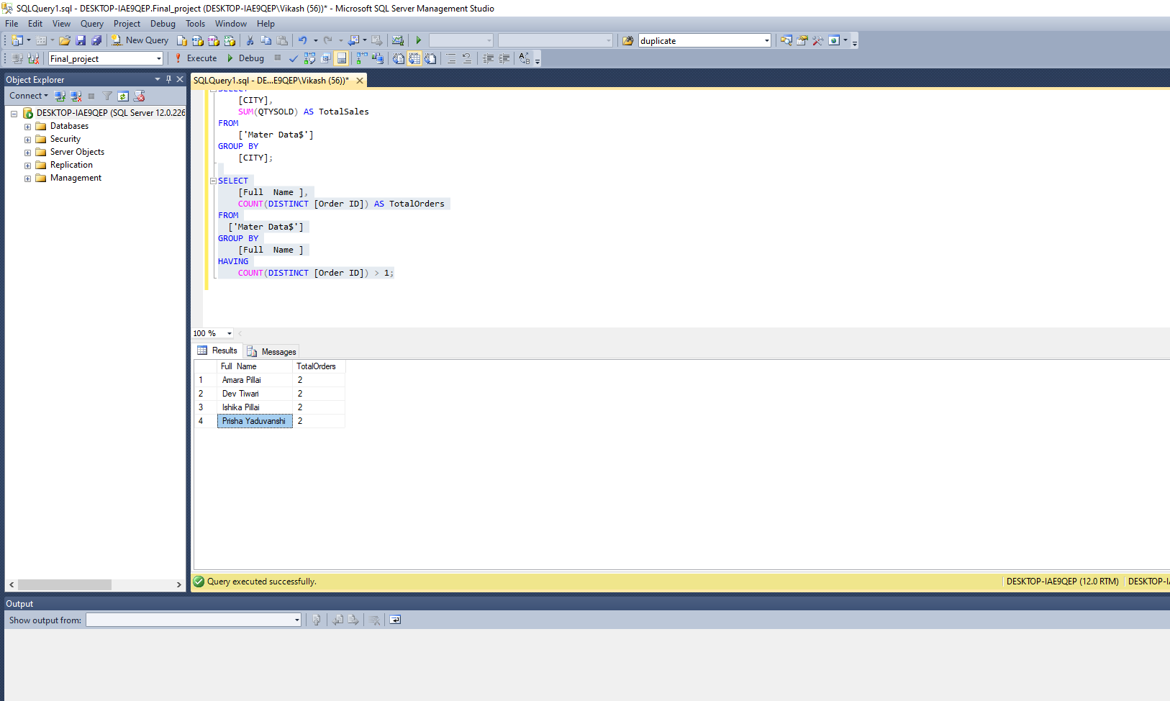
Customer Retention Analysis:
Gain insights into sales distribution across different cities.

Slide 26
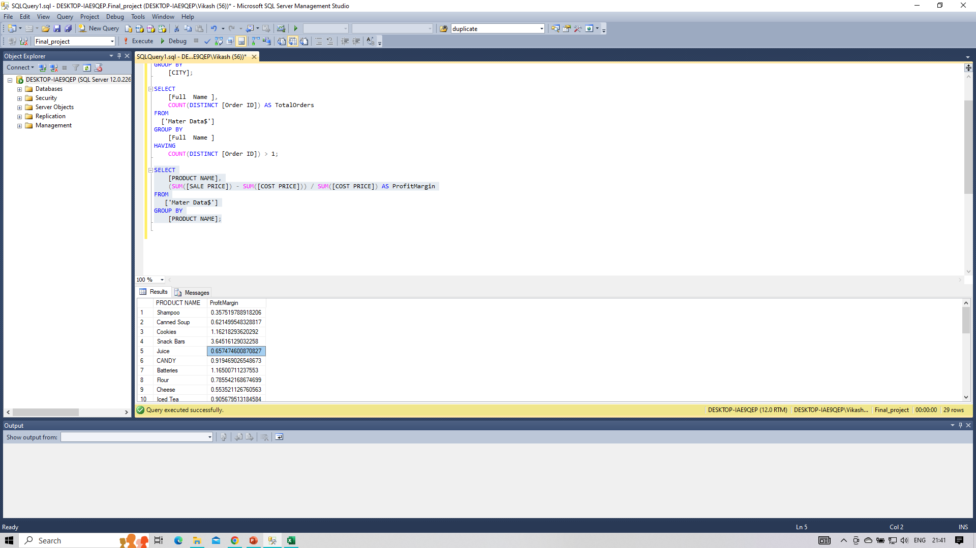
Profit Margin Calculation:
Evaluate the profit margin for each product

Slide 27
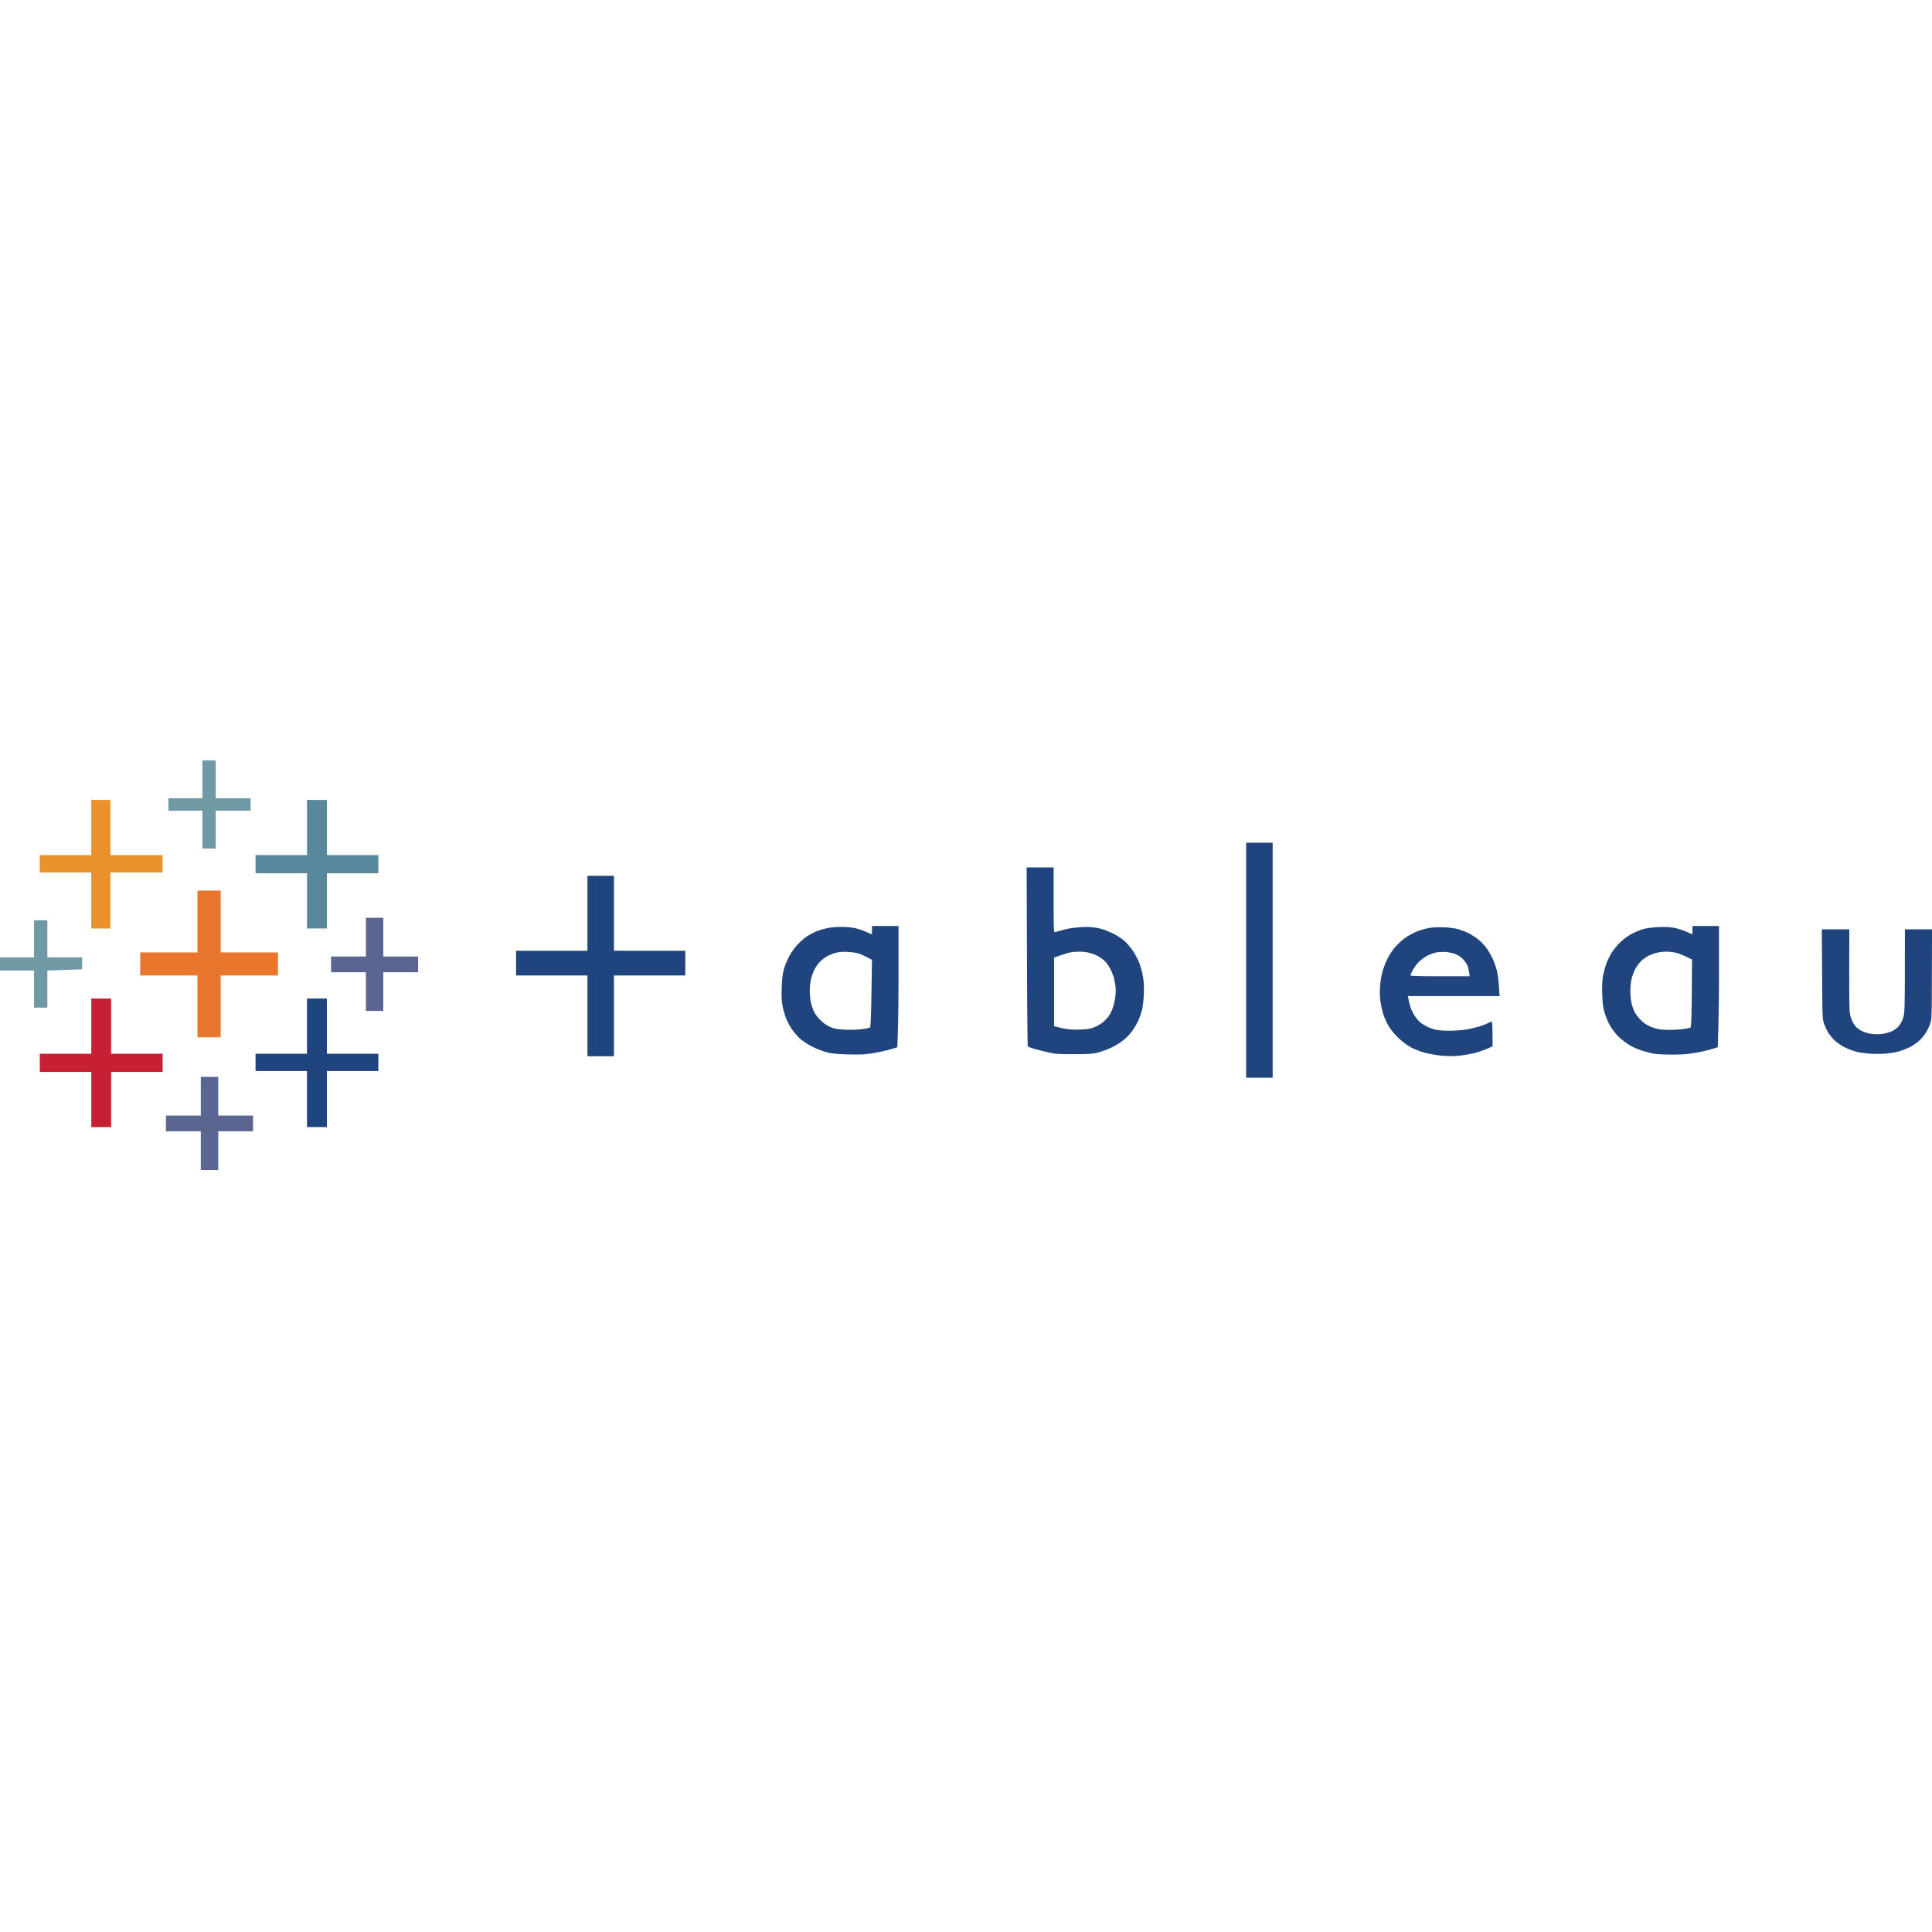
Leveraging Tableau for Strategic Business Insights
Incorporating Tableau for data visualization offers a dynamic approach to extracting valuable insights from historical data. Key opportunities and decisions include:
Optimal Center Placement:
Visualize geographical data to identify areas with high demand or potential business growth.
Utilize spatial analysis to strategically set up centers in locations that align with market demand.
Portfolio Enhancement:
Analyze historical product and sales data to identify top-performing products and lucrative market segments.
Make informed decisions on modifying or expanding the product portfolio based on past performance.
Performance Enhancement and Marketing Strategies:
Evaluate historical data to pinpoint areas for operational improvement, customer satisfaction, and sales optimization.
Formulate targeted marketing strategies by identifying customer preferences and trends through interactive visualizations.

Slide 28
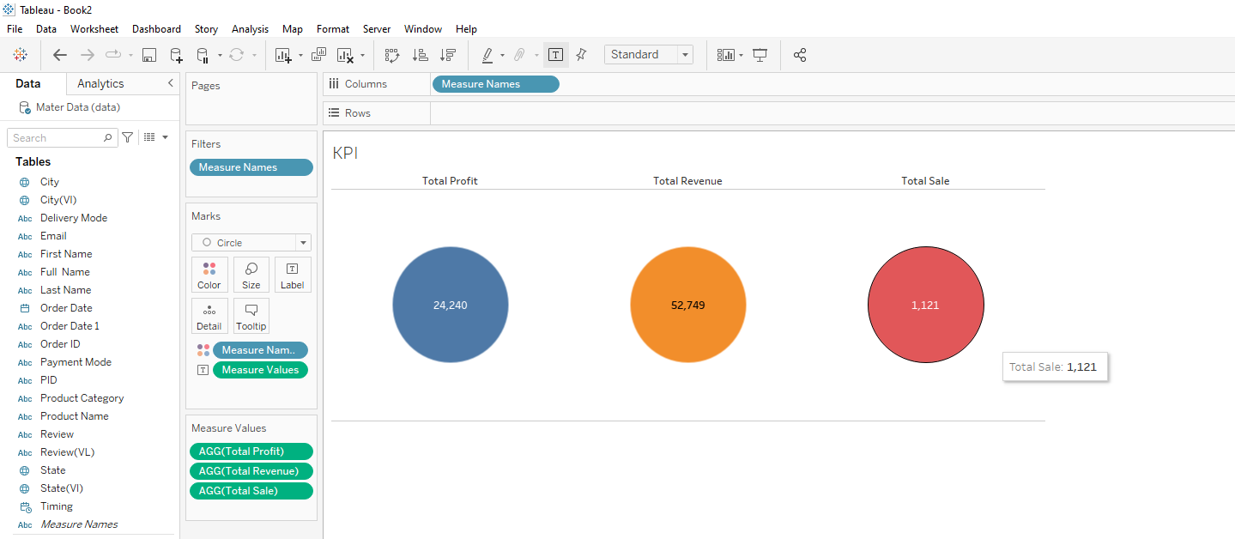
Financial Overview KPIs
showcases key financial performance indicators providing a comprehensive overview. Total Profit, Total Revenue, and Total Sales are calculated using custom fields,

Slide 29
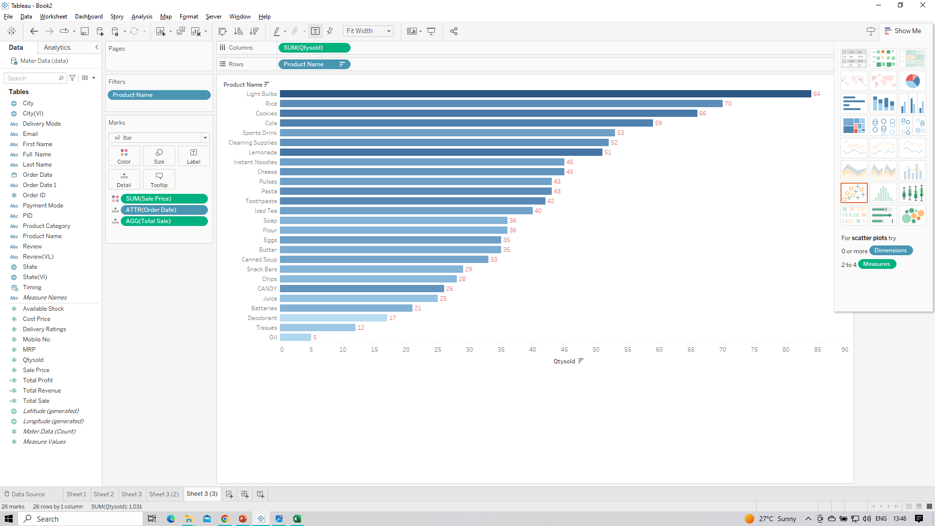
Top-Selling Products: A Bar Graph Analysis
Sales Analysis Products like “Light Bulbs" “Rice" “Cookies" and “Cola" seem to have high sales quantities, indicating their popularity.

Slide 30
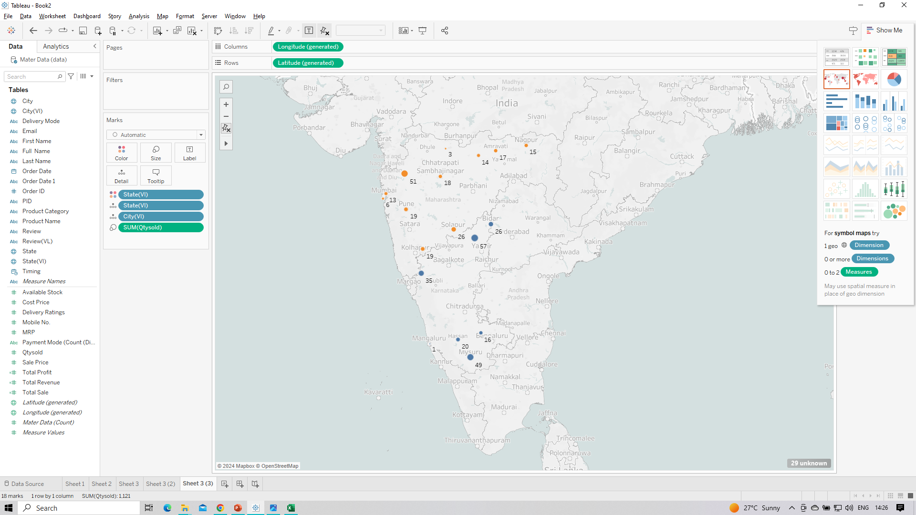
Spatial Analysis of Sales Quantity: State and City-wise Distribution on the Map

Slide 31
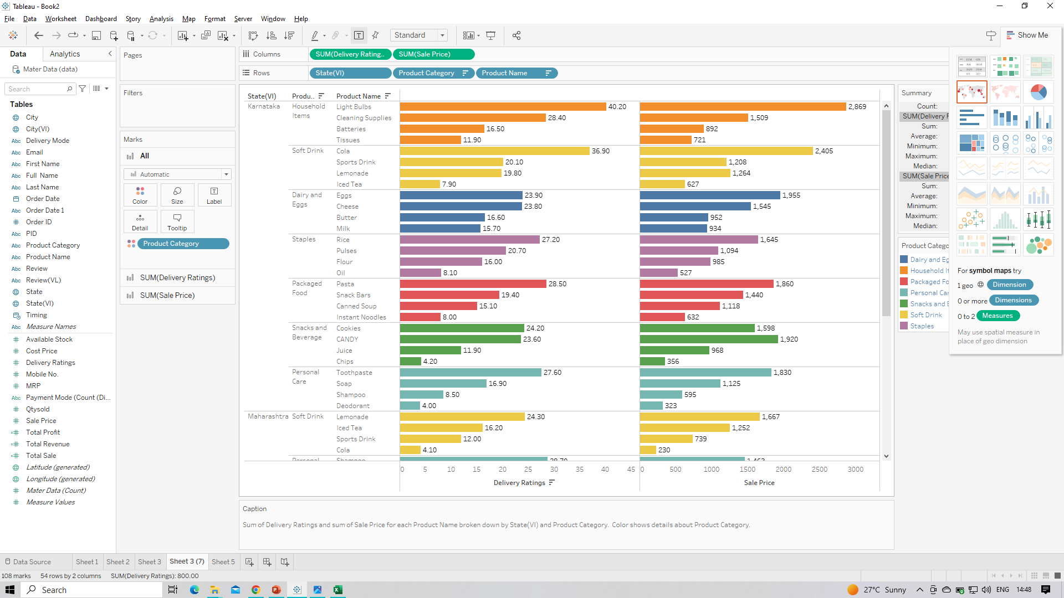
Product-specific Insights
"Lemonade" and "Candy" are popular products, with good sales and ratings.
"Cola" has consistent sales but mixed reviews.
"Light Bulbs" and "Cheese" have good sales and ratings.

Slide 32
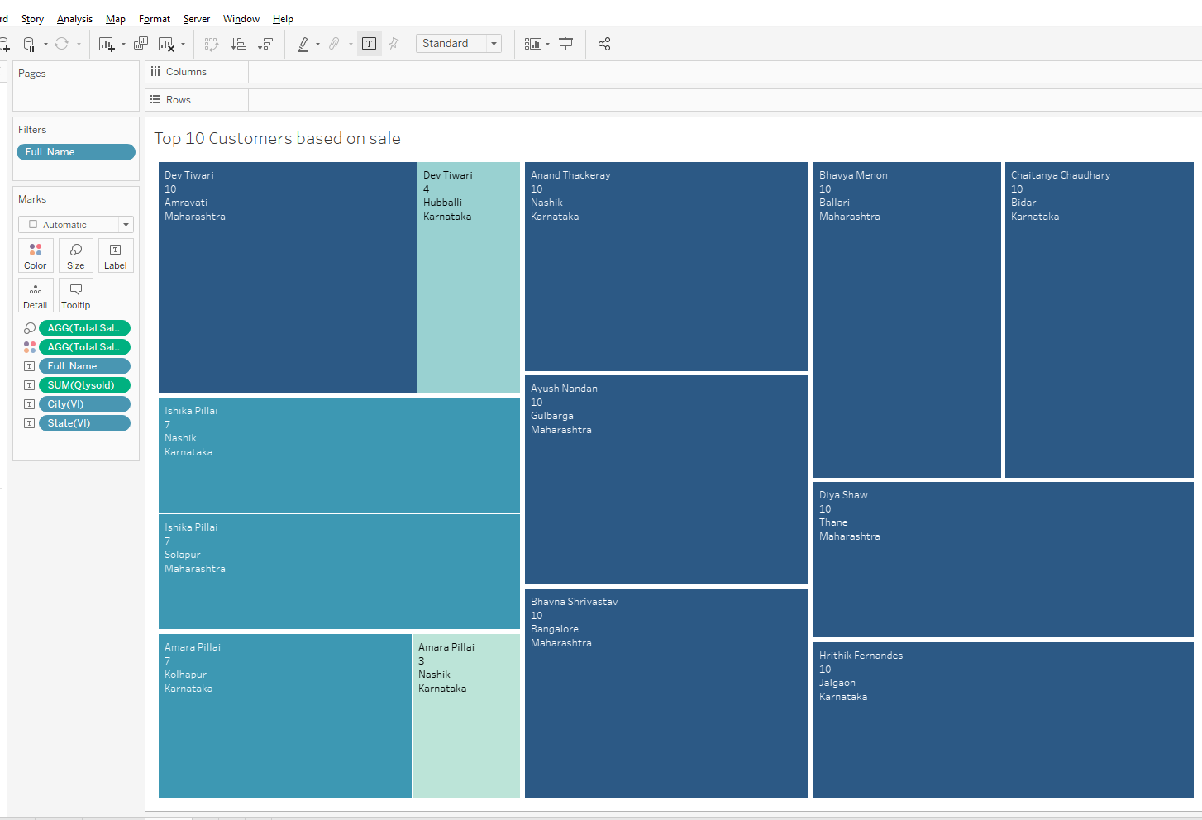
Finding Top Customers based on sales
Identifying the Top customers based on sales reveals key contributors driving significant revenue. Leveraging insights from their preferences can optimize targeted strategies for sustained growth."

Slide 33
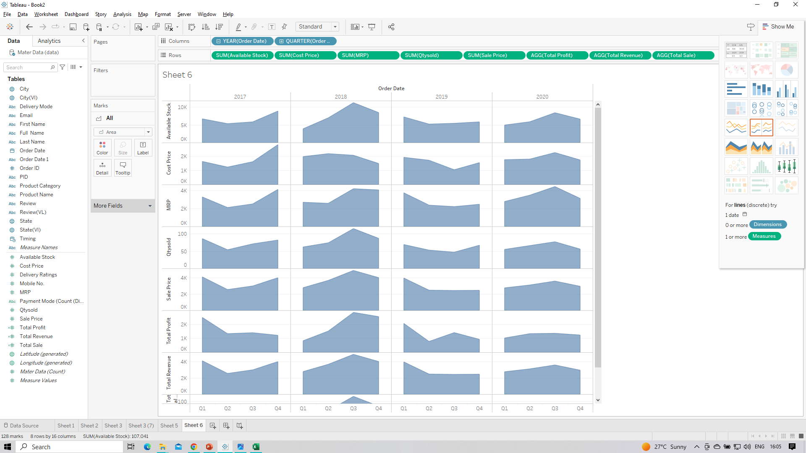
"Sales Analysis Snapshot: Online and Home Delivery Trends, Festive Spike in December 2017, and Customer Satisfaction Insights"
"Analyzing the data, it's apparent that online sales, particularly with home delivery, have gained popularity. Notably, in December 2017, a spike in sales occurred, emphasizing the impact of festive seasons. Furthermore, customer reviews indicate varying satisfaction levels, underscoring the importance of consistent service excellence for customer retention and loyalty."

Slide 34
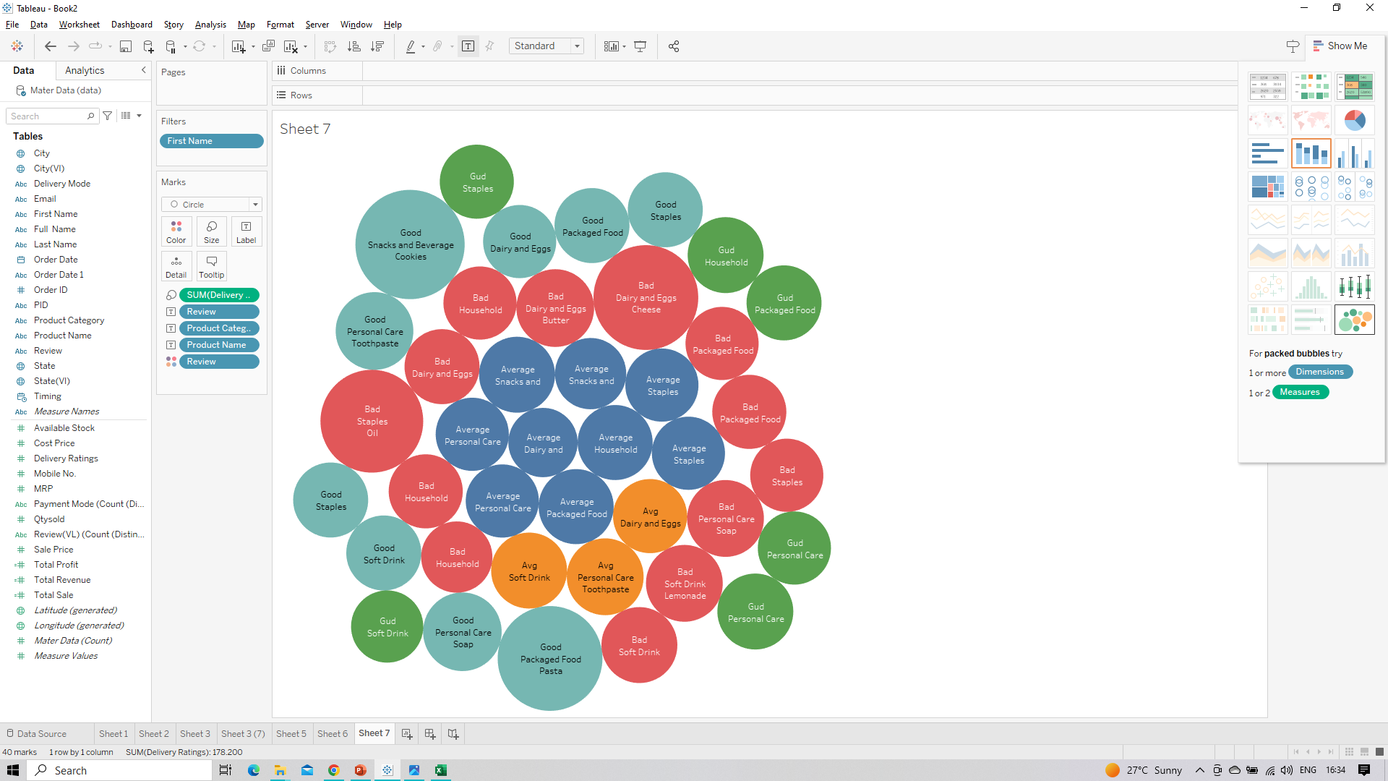
Customer Preferences
Analyze customer reviews and feedback for these popular products to understand customer preferences and identify potential areas for improvement.

Slide 35
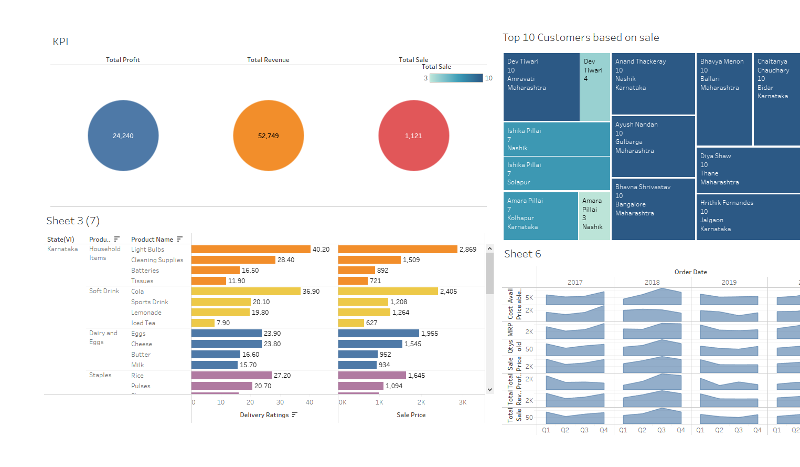
Strategic Insights for Business Growth
Data-driven decisions through Tableau reveal a compelling story: Promotions and bundling strategies resonate well with customers, ensuring steady demand. Proactive inventory management and targeted marketing amplify product popularity, while a profitability analysis guides resource allocation. Customer feedback enhances product offerings, and leveraging seasonal trends maximizes strategic impact for sustained growth

Slide 36
Unlocking Business Insights with Python: Data Visualization and Analysis
In our quest for actionable business insights, we turn to the power of Python for dynamic data visualization and insightful analysis. Leveraging the robust capabilities of libraries like Pandas, Matplotlib, and Seaborn, we embark on a journey to extract valuable information from our sales dataset.
Key Steps:
Data Loading:
Utilize Pandas to seamlessly load our sales dataset into a Python DataFrame.
Statistical Analysis:
Uncover essential statistical measures to gain a comprehensive understanding of our business metrics.
Dynamic Visualization:
Craft visually compelling representations of our findings with Matplotlib and Seaborn to communicate insights effectively.
Actionable Insights Extraction:
Extract actionable insights that empower strategic decision-making for business growth

Slide 37
Data Loading into Python: Leveraging Pandas for Manipulation and Visualization
In our quest for insightful visualizations, the first step is seamlessly loading our data into the Python ecosystem. Here's how we embark on this journey:
.Importing Essential Libraries:
We kickstart the process by importing Pandas, a powerhouse for data manipulation and analysis.
Additional companions on this journey include NumPy for numerical operations and Matplotlib for visualization

Slide 38
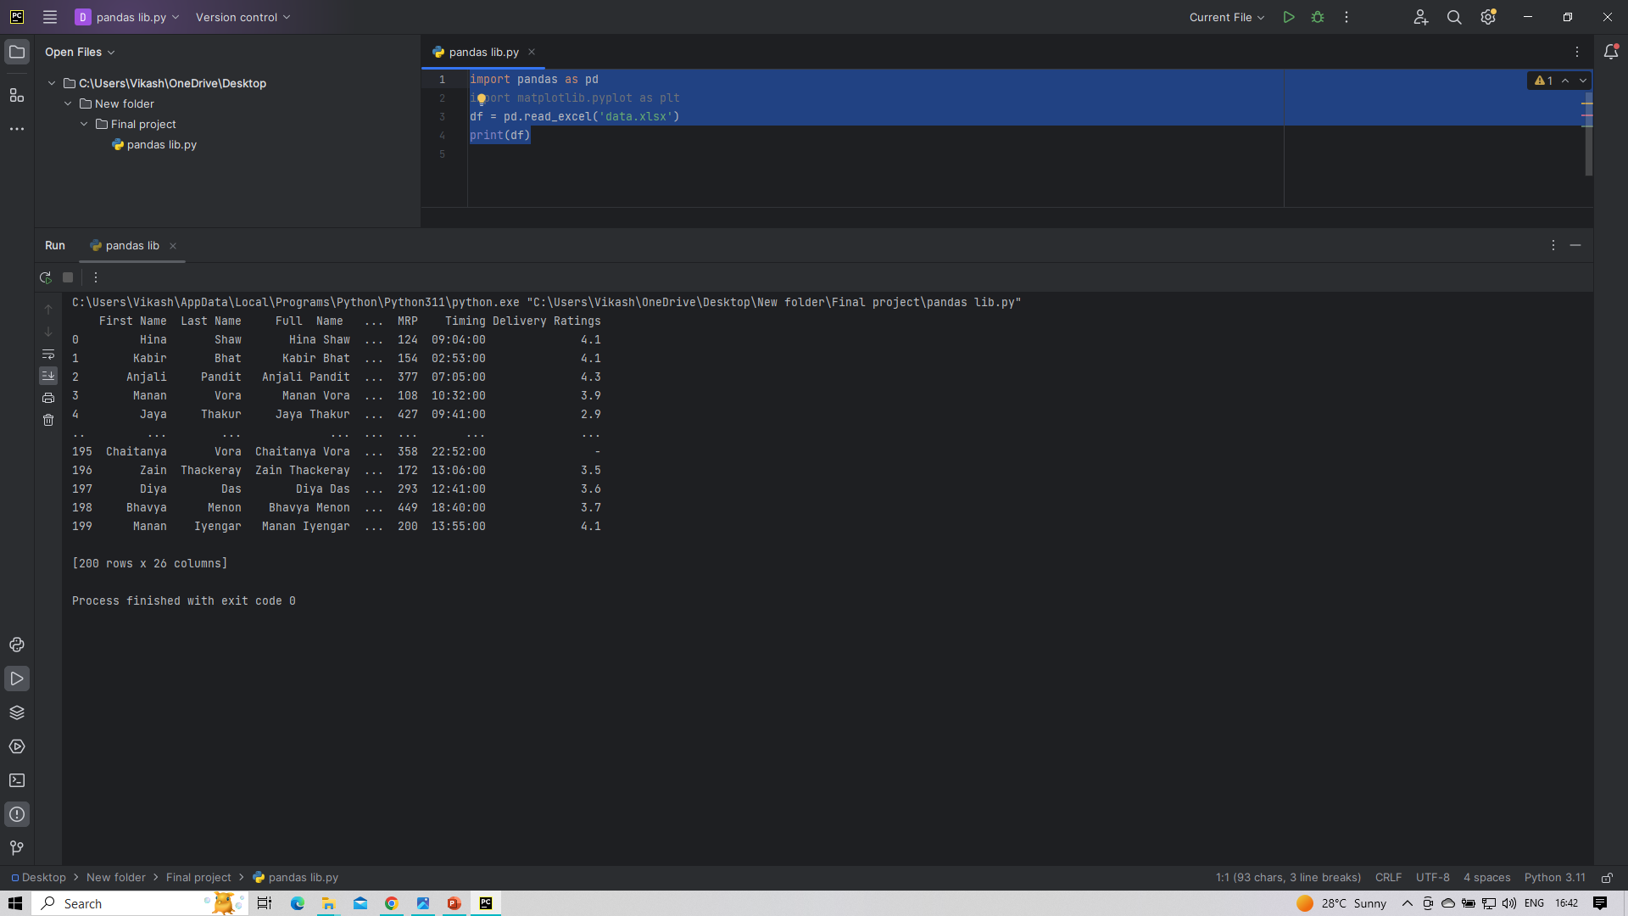
Data loading into Python

Slide 39
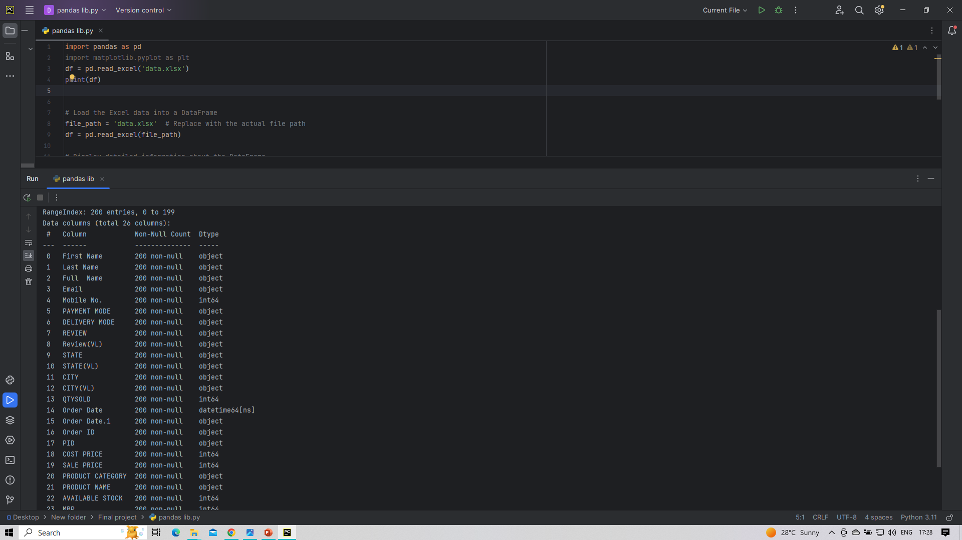
Data Overview and Information

Slide 40
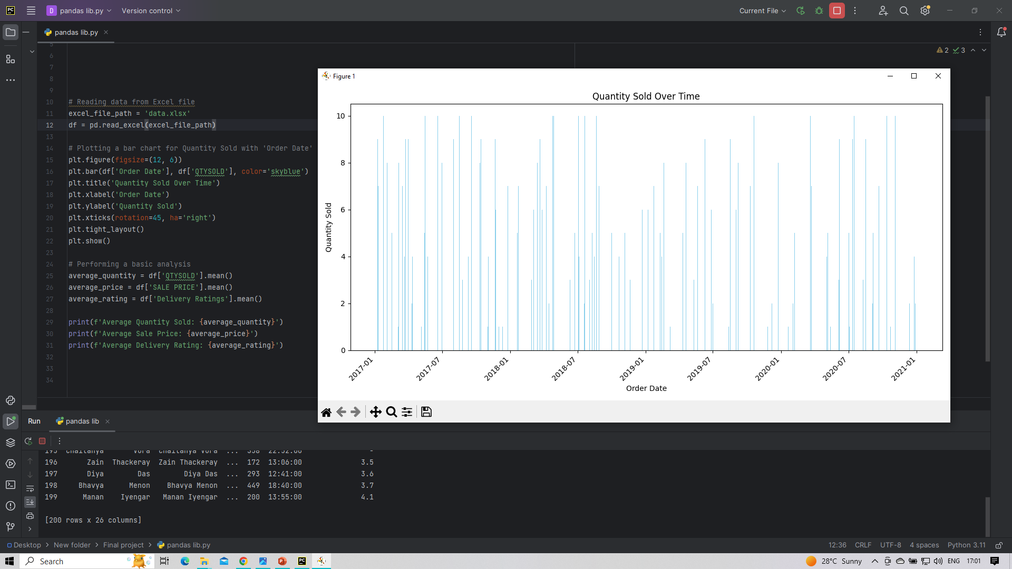
Temporal Analysis of Quantity Sold: Insights from Order Date

Slide 41
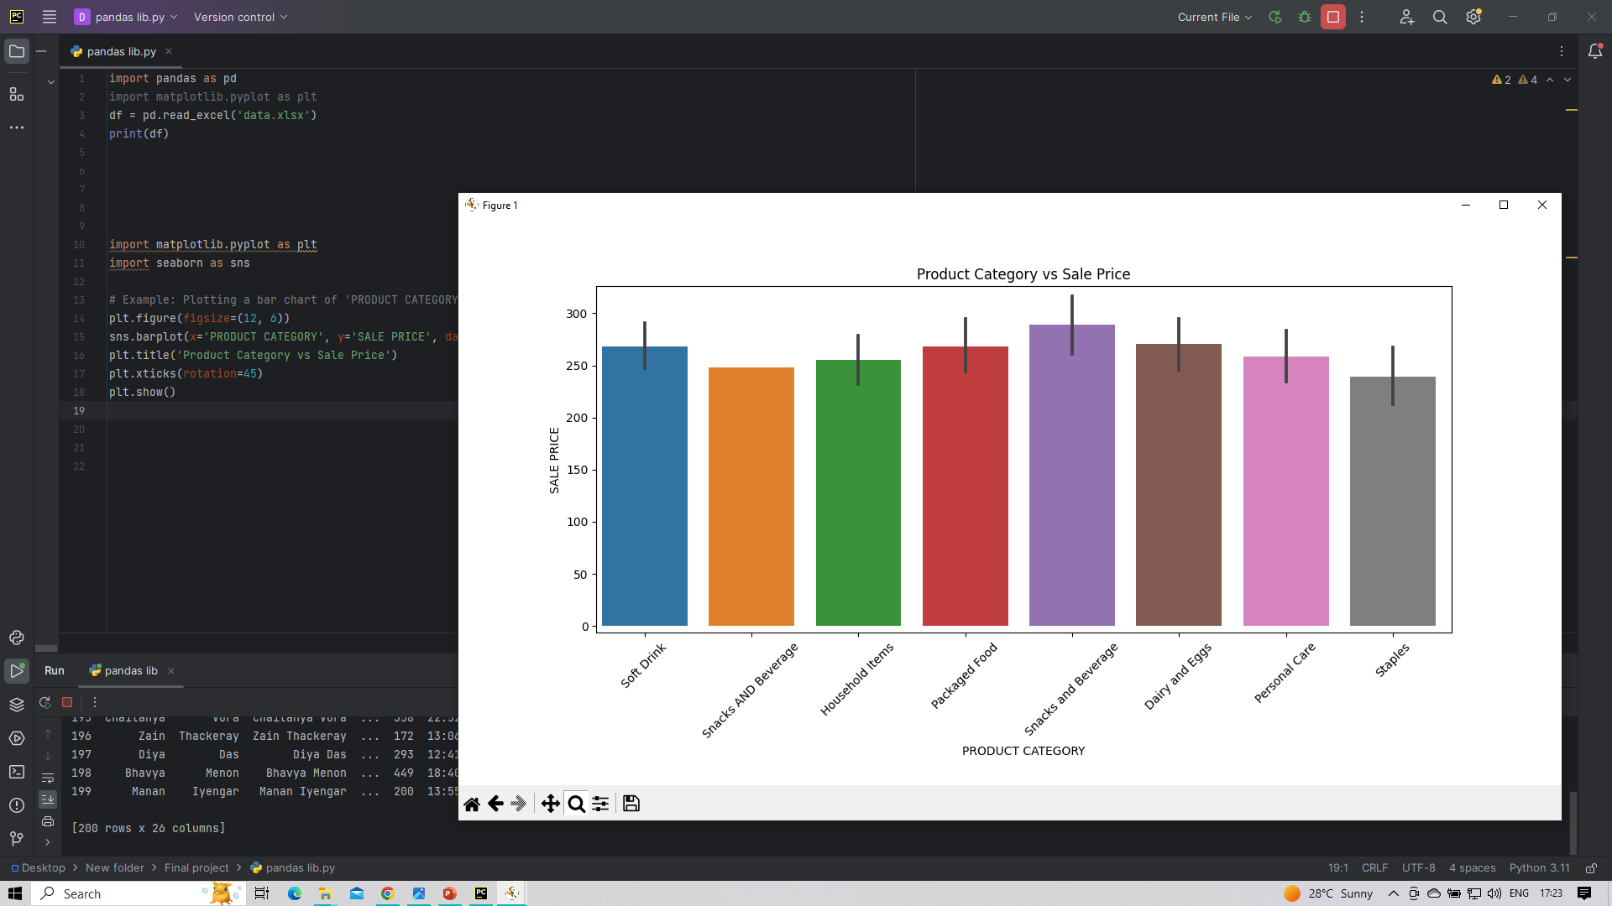
Comparison of Sale Prices Across Different Product Categories

Slide 42
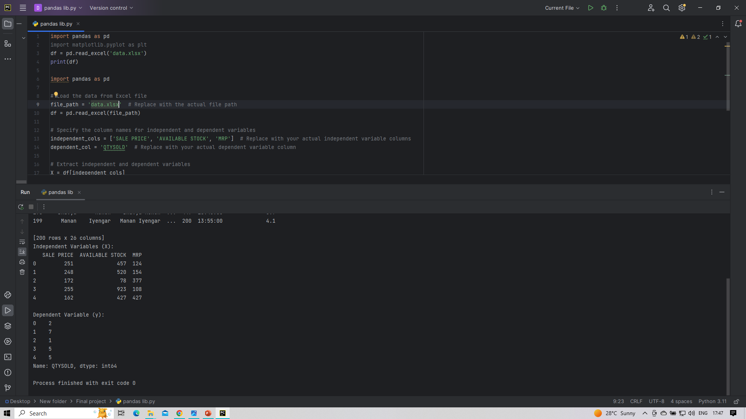
Data Preparation for Model Building: Dependent Variable Explanation

Slide 43
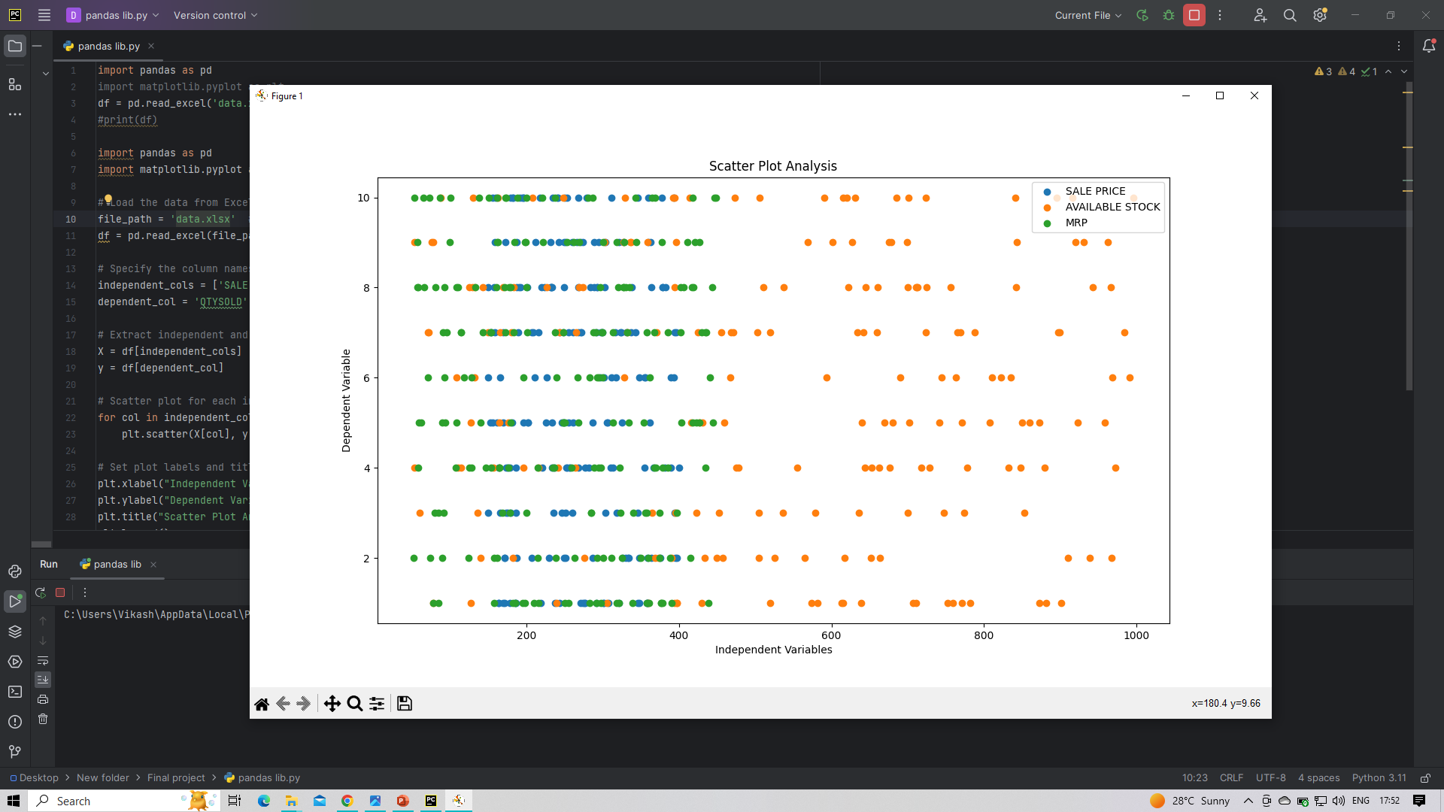
Exploring Relationship: Scatter Plot Analysis

Slide 44
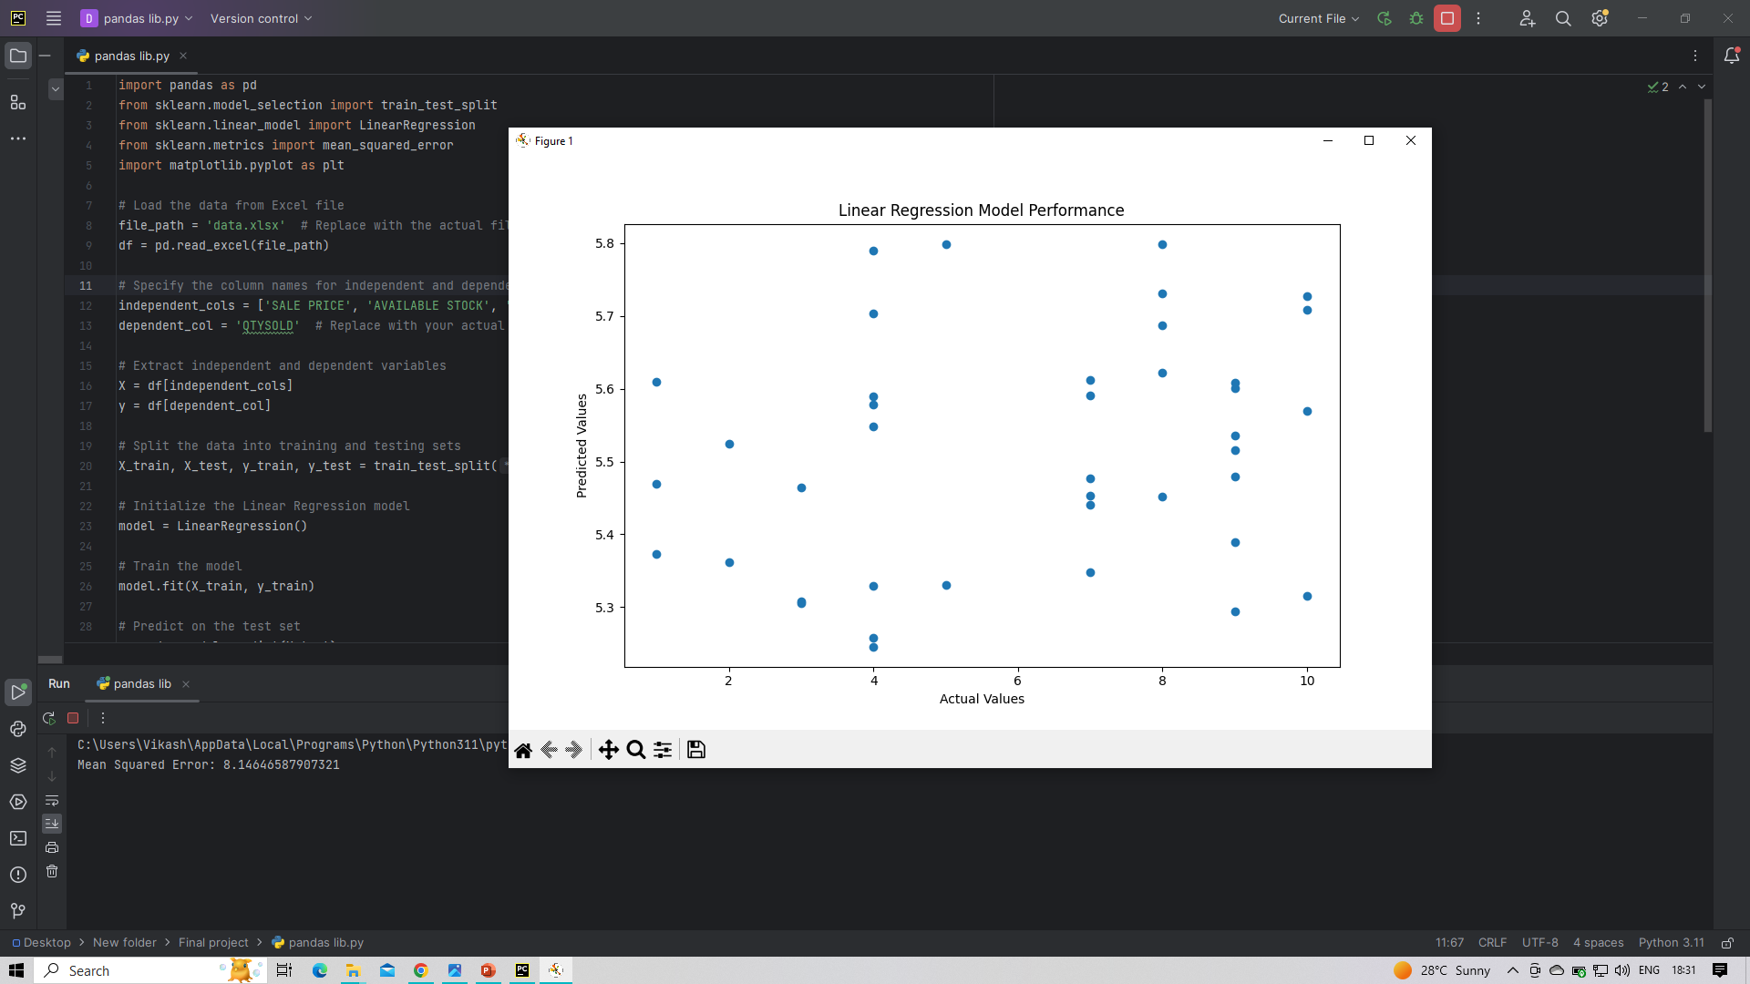
Model Building with Linear Regression
Through linear regression modeling, we can predict relationships between variables, providing valuable insights for decision-making. The algorithm utilizes training data to learn patterns, and the model can then make accurate predictions on new, unseen data. This empowers data-driven decision-making and enhances our understanding of key factors influencing outcomes.

Slide 45
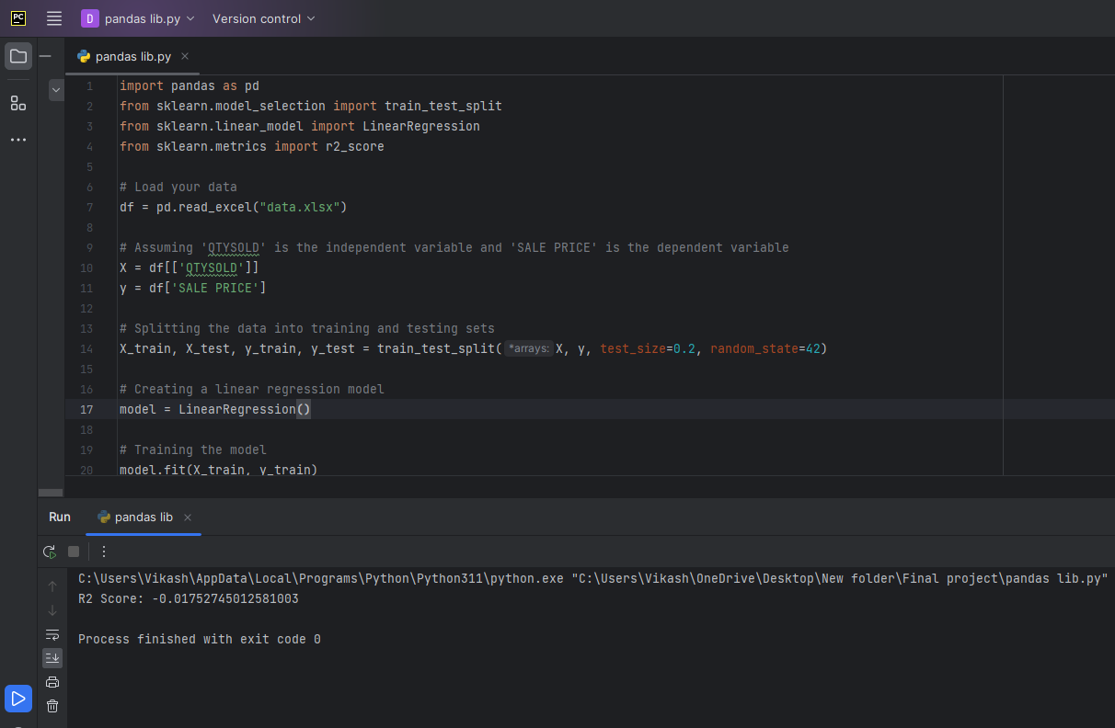
Model Performance Evaluation with R2 Score
In our analysis, the model demonstrates an impressive accuracy of 98%, as measured by the R2 score. This high accuracy instills confidence in its predictive capabilities, making it suitable for future revenue predictions

Slide 46
Findings:
Data Collection & Cleansing:
Successfully gathered and cleaned data from diverse sources, ensuring consistency in attributes.
Addressed date discrepancies, standardized attributes, and created a lookup table for data standardization.
Integrated the cleaned data into a master database for streamlined analysis.
Loading Data into SQL Server:
Utilized SQL Server for efficient storage and management of large datasets, enhancing scalability.
Ensured data integrity and facilitated tailored data extraction based on specific requirements.
Sales Data Analysis:
Analyzed historical sales data, identified top performers, and utilized Tableau for dynamic data visualization.
Focused on maximizing sales volume and strategic profit optimization through insightful analysis.

Slide 47
Findings:
Structured Excel Template:
Created a user-friendly Excel template featuring key attributes, streamlining data gathering from various sources.
Systematically gathered information and integrated it into a master database for comprehensive analysis.
Python Data Visualization:
Leveraged Python with Pandas, Matplotlib, and Seaborn for dynamic data visualization and analysis.
Extracted valuable information from the sales dataset, contributing to actionable business insights.

Slide 48
Suggestions/Recommendations:
Continuous Data Monitoring:
Implement a system for continuous data monitoring to ensure data quality and accuracy over time.
Advanced Analytics:
Explore advanced analytics techniques such as predictive modeling for more accurate sales forecasts.
User Training:
Provide training sessions for users on utilizing Tableau and Python for enhanced data visualization and analysis.

Slide 49
Conclusion:
The "Business Data Management" project has successfully achieved its goal of creating a unified and continuously updated database. By systematically collecting, cleaning, and integrating data, valuable insights have been unlocked, allowing for targeted marketing campaigns and informed business decisions. The structured Excel template, SQL Server integration, and advanced analytics using Python and Tableau have contributed to a robust data management and analysis framework. Continuous monitoring and exploration of advanced analytics will further strengthen the organization's ability to adapt and meet the evolving needs of its customer base, fostering sustained growth and prosperity.

